Slide 1

Training @ Silver touch technologies ltd.
A leader in systems integration & digital transformation
since 1995

Slide 2
API Development Using Asp.Net Core Web API

Slide 3
API Development Using Asp.Net Core Web API
A practical approach for developing the APIS in asp.net core
API Development Using Asp.NET Core Web API

Slide 4
PREFACE
API Development Using Asp.Net Core Web API in this book we adopted a practical approach for the development of software products. This book is divided into four parts every part has its dimension. This book will explain the fully featured projects and how we can architect the application using the following architectures.
What is Restful Web Service
Introduction to API Development
API Development Using Asp.net Core
API Development Using Onion Architecture.
API Testing Using Swagger
API Testing Using Postman
API Deployment on Azure Cloud
API Deployment on Hosting Server
PART 1: API Development Using Asp.net Core
Introduction
Why Restful Web Service
Implementation
Conclusion
Complete Project GitHub URL
PART 2: API Development Using Three Tier Architecture.
Introduction
Complete Understanding of Three Tier Architecture
Practical Approach for Architecting the Application with Asp.net Core
Conclusion
Complete Project GitHub URL
PART 3: API Development Using Onion Architecture.
Introduction
Complete Understanding of Onion Architecture
Practical Approach for Architecting the Application with Asp.net Core
Conclusion
Complete Project GitHub URL
PART 4: API Testing Using Swagger.
Introduction
API Testing Using Swagger in Asp.net Core
Test POST, PUT, DELETE, GET, UPDATE Endpoints Using Swagger
Conclusion
API Development Using Asp.NET Core Web API

Slide 5
PART 4: API Testing Using Postman.
Introduction
API Testing Using Postman in Asp.net Core
Test POST, PUT, DELETE, GET, UPDATE Endpoints Using Postman
Conclusion
PART 5: Application Deployment on Azure Cloud.
Introduction
Creation of App on Azure Cloud
Server Configuration in Visual Studio
Deployment Steps Using Visual Studio
Output on Azure Websites
Conclusion
PART 6: Application Deployment on Server.
Introduction
Deployment Procedure
Server Configuration
Deployment Steps
Conclusion
API Development Using Asp.NET Core Web API

Slide 6
Contents
Chapter 1 – What is REST Architecture .............................................................................. 18
What is RESTful Web Service? ............................................................................................... 19
RESTful Web Service Features ............................................................................................... 19
Resources ............................................................................................................................... 19
Request Verbs .......................................................................................................................... 7
Request Header ....................................................................................................................... 8
Request Body ........................................................................................................................... 8
Response Body........................................................................................................................ 8
Response After Positing the Data into Database .................................................................... 9
Response Status Codes ............................................................................................................ 9
RESTful Web Service Methods................................................................................................. 9
Why RESTful Web Service ...................................................................................................... 12
RESTful Architecture .............................................................................................................. 12
RESTful Principals and Constraints ........................................................................................ 13
RESTful Client-Server ............................................................................................................. 13
Stateless ................................................................................................................................. 13
Cache...................................................................................................................................... 14
Layered System ...................................................................................................................... 14
RESTful Web Services Interfaces............................................................................................ 14
Create your first RESTful Web service in Asp.net Core Web API........................................... 13 Data Access Layer .................................................................................................................. 15
RESTful Web Service Results.................................................................................................. 35
Debug the project using visual studio Debugger .................................................................. 35
POST Endpoint in Web API Service ........................................................................................ 36
DELETE Endpoint in Web API Service..................................................................................... 34
GET All Endpoint in Web API Service ..................................................................................... 35
GET End Point for Getting the Record by User Email ............................................................ 35
Delete End Point for Deleting the Record by User Email ...................................................... 36
Update End Point for Updating the Record by User Email.................................................... 37 Testing the RESTful Web Service ........................................................................................... 37
Step 1 Run the Project........................................................................................................... 37
API Development Using Asp.NET Core Web API

Slide 7
Step 2 Test POST End Point................................................................................................. 38
Step 3 Test GET End Point................................................................................................... 39
Step 4 Test DELETE End Point ............................................................................................ 40
Step 5 Test GET by User Email End Point........................................................................... 41
Conclusion.............................................................................................................................. 42
Chapter 2 – API Development In Asp.Net Using Three Tier Architecture ............................ 43
Introduction ........................................................................................................................... 44
Project Structure .................................................................................................................... 44
Presentation Layer (PL) ........................................................................................................ 44
Business Access Layer (BAL) .............................................................................................. 44
Data Access Layer (DAL) .................................................................................................... 44
Add the References to the Project......................................................................................... 47
Data Access Layer .................................................................................................................. 50
Contacts................................................................................................................................. 50
Data ....................................................................................................................................... 52
Migrations ............................................................................................................................. 52
Models................................................................................................................................... 52
Repository ............................................................................................................................. 54
Business Access Layer ............................................................................................................ 57
Services ................................................................................................................................. 58
Presentation layer.................................................................................................................. 60
Advantages of 3-Tier Architecture......................................................................................... 61
Dis-Advantages of 3-Tier Architecture................................................................................... 61 Conclusion.............................................................................................................................. 61
Complete Git Hub Project URL............................................................................................... 62
Chapter 3- API Development In Asp.Net Using Onion Architecture .................................... 63
Introduction ........................................................................................................................... 64
What is Onion architecture.................................................................................................... 64
Layers in Onion Architecture ................................................................................................. 64
Domain Layer ......................................................................................................................... 65
Repository Layer .................................................................................................................... 65
API Development Using Asp.NET Core Web API

Slide 8
Service Layer .......................................................................................................................... 65
Presentation Layer ................................................................................................................. 65
Advantages of Onion Architecture ........................................................................................ 65
Implementation of Onion Architecture ................................................................................. 66 Project Structure.................................................................................................................... 66
Domain Layer ......................................................................................................................... 66
Models Folder ....................................................................................................................... 68
Data Folder............................................................................................................................ 71
Repository Layer .................................................................................................................... 73
Service Layer .......................................................................................................................... 77
ICustom Service.................................................................................................................... 79
Custom Service ..................................................................................................................... 79
Department Service............................................................................................................... 79
Student Service ..................................................................................................................... 83
Result Service ....................................................................................................................... 86
Subject GPA Service............................................................................................................. 89
Presentation Layer ................................................................................................................. 92
Dependency Injection ........................................................................................................... 93
Modify Program.cs File ........................................................................................................ 93
Controllers............................................................................................................................. 94
Output ................................................................................................................................... 98
Conclusion.............................................................................................................................. 99
Complete GitHub project URL................................................................................................ 99
Chapter 4- API Testing Using Postman ............................................................................ 100
Introduction ......................................................................................................................... 101
How to Test API Web Service in Asp Net Core 5 Using Postman ........................................ 101 Test Post Call in Postman..................................................................................................... 105
Test Delete Call in Postman ................................................................................................. 107
Test Get Call in Postman ...................................................................................................... 108
Test Put Call in Postman ...................................................................................................... 109
Conclusion............................................................................................................................ 111
API Development Using Asp.NET Core Web API

Slide 9
Chapter No 5 API Testing Using Swagger ......................................................................... 112
Introduction ......................................................................................................................... 113
How to Test API Web Service in Asp Net Core 5 Using Swagger ......................................... 113 Test POST Call in Swagger .................................................................................................... 114
Test DELETE Call in Swagger ................................................................................................ 116
Test GET Call in Swagger ...................................................................................................... 118
Test PUT Call in Swagger...................................................................................................... 119
Summary .............................................................................................................................. 122
Conclusion............................................................................................................................ 123
Chapter 6- Application Deployment on Azure Cloud........................................................ 124
Introduction ......................................................................................................................... 125
Open Your Azure portal ....................................................................................................... 125
Create Azure Web App ........................................................................................................ 125
Create the Azure Resource Group. ...................................................................................... 126
Select the Name of Your Application................................................................................... 126
Select the Runtime Stack ..................................................................................................... 127
Select the Azure Region ....................................................................................................... 127
Create App Service Plan ....................................................................................................... 128
Select the pricing plan.......................................................................................................... 128
Select the Recommended Pricing Tier................................................................................. 129
Select the Deployment Option. ........................................................................................... 129
Select the Net Working Options .......................................................................................... 130
Select the Azure Monitoring Options .................................................................................. 131
Select the Tags Options........................................................................................................ 132
Review and Create ............................................................................................................... 132
Application Status ................................................................................................................ 135
Get the publish profile. ........................................................................................................ 136
Publish the App Using Visual Studio .................................................................................... 137
Select the Publish Profile ..................................................................................................... 139
Deployment Status .............................................................................................................. 141
Application Deployed on Azure Cloud ................................................................................. 141
Chapter 7- Application Deployment on Server. ............................................................... 142
Introduction ......................................................................................................................... 143
API Development Using Asp.NET Core Web API

Slide 10
Step 1 Account Setup on Server .......................................................................................... 143
Step 2 Create the project asp.net Core 5 Web API using VS-2019...................................... 143 Step 3 Set the Live Server Database Connection string in your application appsetting.json file
.............................................................................................................................................. 144
Step 4 Publish Your Project.................................................................................................. 144
Step 5 Validate the Connection ........................................................................................... 150
Conclusion............................................................................................................................ 154
References ........................................................................................................................... 155
Feedback .............................................................................................................................. 156
API Development Using Asp.NET Core Web API

Slide 11
Chapter 1 – What is REST Architecture
What is RESTful Web Service?
RESTful Web Service Features
RESTful Web Service Methods
Why RESTful Web Service
RESTful Architecture
RESTful Principals and Constraints
RESTful Client-Server
Layered System
RESTful Web Services Interfaces
Create your first RESTful Web service in Asp.net Core Web API
Data Access Layer
Business Access Layer
Presentation Layer
API Development Using Asp.NET Core Web API

Slide 12
What is RESTful Web Service?
Restful web services are a lightweight maintainable and scalable service that is built on the REST Architecture. Restful Web service exposes API from your application in a secure uniform stateless
manner to the calling client can perform predefined operations using the restful service the protocols for the REST is HTTP and Rest is a Representational State Transfer. Representational
state transfer (REST) is a de-facto standard for a software Architecture or Interactive applications that use Web Service a Web Service that follows this standard is called RESTful such web must
provide its web resources in a textual representation and allow them to be read and modified with stateless protocol and predefined set of operations this standard allow interoperability between a
Machine and the Internet that provide these services. REST Architecture is alternative to SOAP and SOAP Architecture is the way to access a Web Service.
RESTful Web Service Features
Rest Web services have come a long way since their inception. In 2002 the Web Consortium had released the definition of WSDL and SOAP Web services and this formed the standard of how
web services are implemented in 2004 the web consortium also released the definition of an additional standard called RESTful in past four to five years this standard has become more
popular and being used in many giants like Facebook and Twitter Microsoft. REST is a way to access resources that lie in an articular environment you could have a server that could be hosting
important documents or pictures or videos. All these are an example of the resources if a client says a web browser needs any of these resources it must send a request to the server to access the
resources.
The key features of the RESTful implementation are as follows:
Resources
The first key feature is the resource itself. Let us assume that a web application on the server has
a record of Persons if we want to access the records of the Persons by Id the details are in the given below figure the coding part is also given.
API Development Using Asp.NET Core Web API

Slide 13
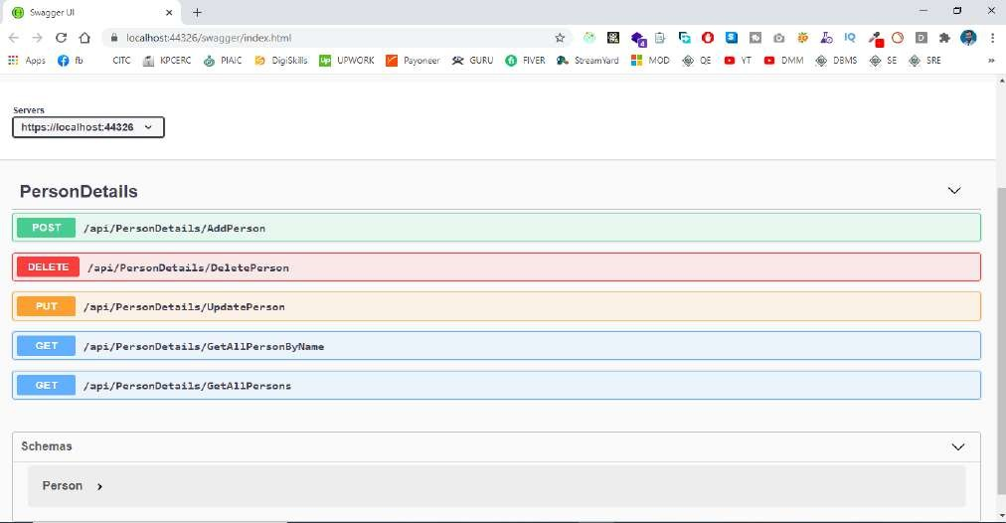
Request Verbs
This describes what you want to do with the resources a browser issues a GET verb to instruct the endpoints it wants to get the data like POST is used to send the data by hitting the endpoints in
the postman or swagger and PUT is used to update the data and DELETE is used to either soft delete the record or on permanent bases.
As shown in the below figure.
API Development Using Asp.NET Core Web API

Slide 14
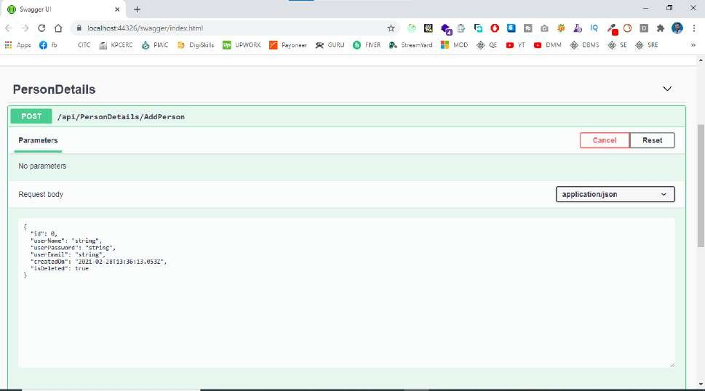
Request Header
These are the additional instructions sent with the request these might define the types of the response required or authorization details
Request Body
Data is sent with the requested data is normally sent in the request when a POST request is made
to the REST web service in a POST call the client tells the rest web Service that it wants to add a resource to the server hence the request body would have the details of the resources which is required to be added to the server. As shown in the figure below.
Response Body
This is the main body of the response so in our RESTful API Example if we were to query the
web service via the GET Request, we server returns the response in the JSON format which gives us the details of Persons according to the Person ID.
API Development Using Asp.NET Core Web API

Slide 15
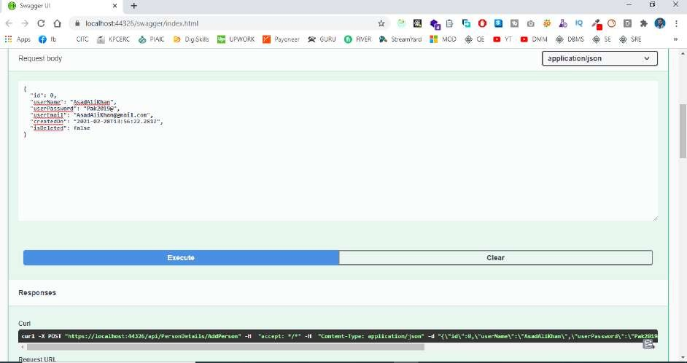
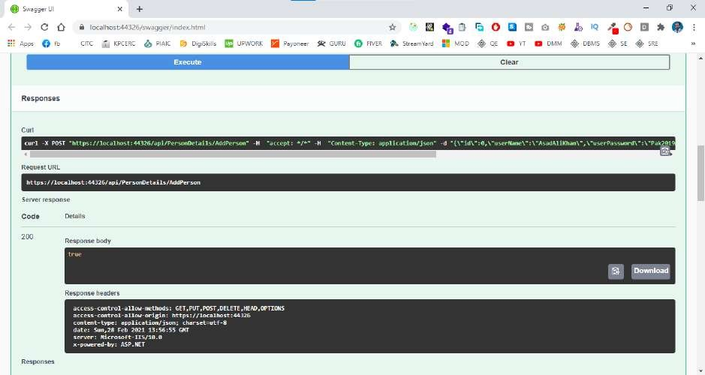
For Posting the Data
Response After Positing the Data into Database
API Development Using Asp.NET Core Web API

Slide 16
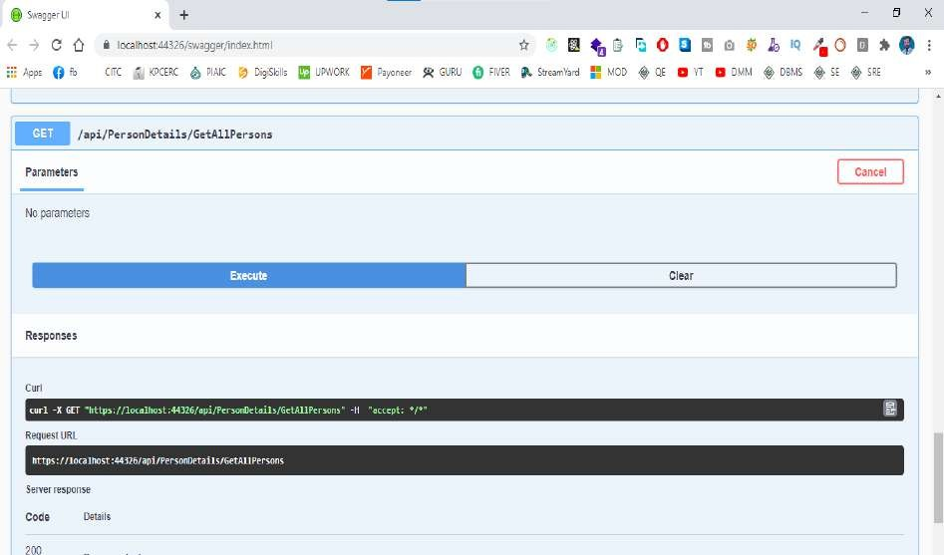
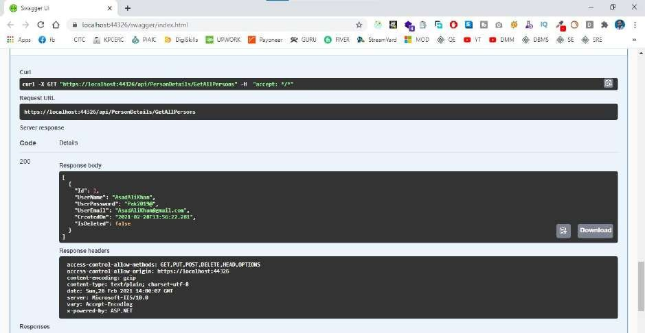
API Development Using Asp.NET Core Web API

Slide 17
Response Status Codes
These codes are the general codes that are returned along with the response from the webserver the status code details are the given below table.
Code |  | Response
1 | 100 - 199 | Informational Response
2 | 200 - 299 | Successful Response
3 | 300 - 399 | Redirects
4 | 400 - 499 | Client Error
5 | 500 - 599 | Server Error
RESTful Web Service Methods
Web Resources were first defined on the world wide web as documents of files identified by their URLs today the definition is much generic and abstract and includes everything entity or action
that can be identified Named Addressed handled or performed in any way on the web in a RESTful web service requests made to a resources URI gives us the response with the payload formatted
in HTML XML JSON or some other format, for example, the response can be related resources the most common protocol is HTTP provides us following HTTP Methods GET, POST, PUT,
PATCH, DELETE, CONNECT, OPTIONS AND TRACE.
The HTTP methods details are given below.
POST is used to post the data from the webserver to the database using the RESTful Web Service.
GET is used to get the list of all records from the database either all records or based on specific I’d like Person ID or employed.
DELETE is used to delete all the records from the database or based on a specific Id.
PUT is used to Replace the record or update a record based on Specific Id.
PATCH method provides an entity containing the list of changes to be applied to the resources requesting using the HTTP Request-URI.
OPTIONS The options method represents a request for information about the communication options available on the request/response chain identified by Request- URI.
API Development Using Asp.NET Core Web API

Slide 18
TRACE The trace method performs a message look back test along the path to the target resources providing a useful debugging mechanism.
API Development Using Asp.NET Core Web API

Slide 19
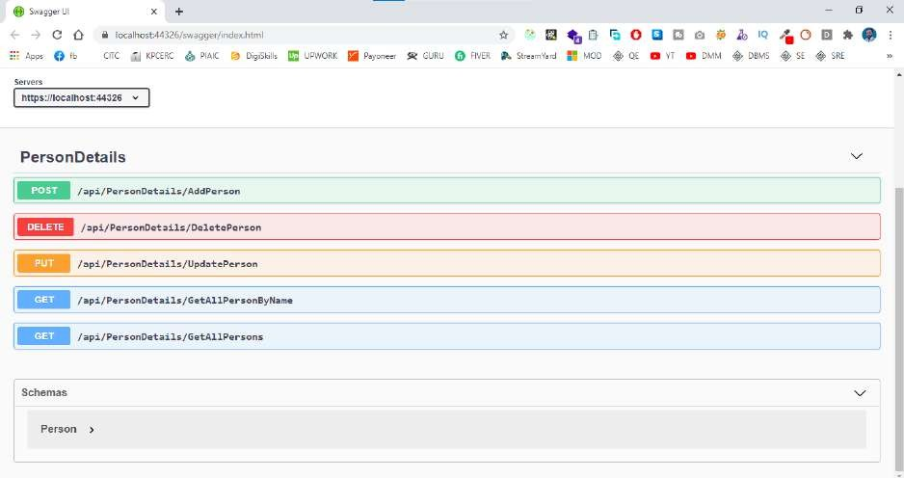
Why RESTful Web Service
Restful Mostly comes into popularity due to the following features.
Heterogeneous language and environment this is one of the fundamental reasons which is same as we have seen for SOAP as well
It enables web applications that are built on various programming languages to communicates with each other.
RESTful web architecture helps the web applications to reside in different environments some could be on windows and others could be on Linux.
RESTful web service offers this flexibility to applications built on various programming languages and platforms to talk to each other.
RESTful Architecture
An Application OR Architecture considered RESTful or Rest Style has the following Characteristics
A-State and functionality are divided into distributed resources which means that every resource should be accessible via the normal HTTP Commands like getting, POST, PUT, DELETE, if someone wanted to get a file from a server, they should be able to issue the GET request and get the file. If we want to put the file on the server, we will use either
API Development Using Asp.NET Core Web API

Slide 20
POST or PUT request, and finally, if we want to delete the file from the storage, we must use a DELETE request.
The architecture is client/server stateless layered and supports the caching.
The client-server is the typical architecture where the server can be web server hosting the application and the client can be as simple as the web browsers.
Stateless means that the state of the application is not maintained in REST
If we want to delete a resource from a server using the DELETE Command, you cannot pass the deleted information to the next request. To ensure that the resources are deleted you would need to issue the GET request first to get all the information from the server after which one would need to see if the resource were deleted.
RESTful Principals and Constraints
The REST architecture is based on few characteristics which are elaborated below any RESTful
web service must comply with the below characteristics for it to be called RESTful these characteristics are known as design principle which need to be filled when working with RESTful based architecture.
RESTful Client-Server
This is the most fundamental requirement of the REST Based architecture it means that the server
will have a RESTful web service that would provide the required functionality to the client. The client sends a request to the web service on the server would either reject the request on complying and provide ab adequate response on the client,
CLENT
SERVER
Stateless
The concept of stateless means that it is up to the client to ensure that all the required information
is provided to the server. This is required so that server can process the response appropriately the server should not maintain any soft of the information between requests from the client requests the server and the server give the response to the client appropriately.
API Development Using Asp.NET Core Web API

Slide 21

Cache
The Cache concept is to help with the problem of stateless which was described in the last point
since each client request is independent sometimes the client might ask the server for the same request again even though it had already asked for it in the past. This is even though it had already asked for it in the past. This request will go to the server and the server will give a response. This increase the traffic across the network the cache is the concept implemented on the client to store requests which have already been sent to the server so if the same request is given by the client instead of going to the server this saves the amount of to and fro network traffic from the client to the server.
Layered System
The concept of a layered system is that any additional layer such as a middleware layer can be
inserted between the client and the actual server hosting the RESTful web service the middleware layer is where all the business logic is created this can be an extra service created with a client could interact with before it makes a call to the web service. the layered system needs to be transparent so that interaction between client and server should Not Be Affected in any way.
RESTful Web Services Interfaces
This is the underlying technology in the web service how RESTful should work. RESTful works on the HTTP web layer and uses the below key verb to work with resources on the server. Web
Resources were first defined on the world wide web as documents of files identified by their URLs today the definition is much generic and abstract and includes everything entity or action that can
be identified Named Addressed handled or performed in any way on the web in a RESTful web service requests made to a resources URI gives us the response with the payload formatted in
HTML XML JSON or some other format, for example, the response can be related resources the
API Development Using Asp.NET Core Web API

Slide 22
most common protocol is HTTP provides us following HTTP Methods GET, POST, PUT, PATCH, DELETE, CONNECT, OPTIONS AND TRACE.
The HTTP methods details are given below.
POST is used to post the data from a web server to the database using the RESTful Web Service.
GET is used to get the list of all records from the database either all records or based on specific I would like Person ID or employed.
DELETE is used to delete all the records from the database or based on a specific Id.
PUT is used to Replace the record or update a record based on a Specific Id.
PATCH method provides an entity containing the list of changes to be applied to the resources requesting using the HTTP Request-URI.
OPTIONS The options method represents a request for information about the communication options available on the request/response chain identified by Request- URI.
TRACE The trace method performs a message look back test along the path to the target resources providing a useful debugging mechanism.
API Development Using Asp.NET Core Web API

Slide 23
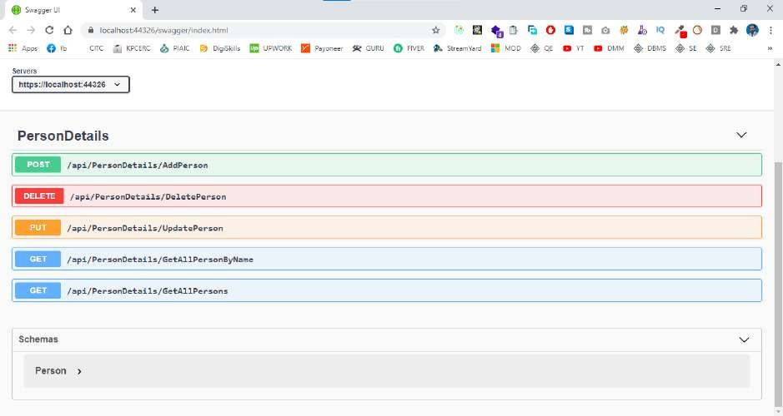
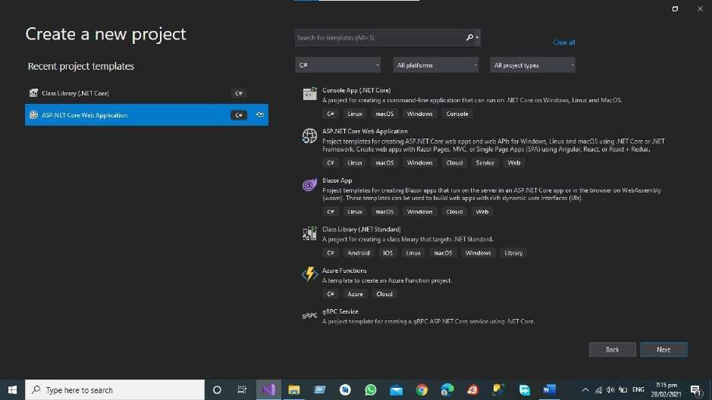
Create your first RESTful Web service in Asp.net Core Web API
Step 1 First, Create the Asp.net Core Web API in Visual Studio.
API Development Using Asp.NET Core Web API

Slide 24
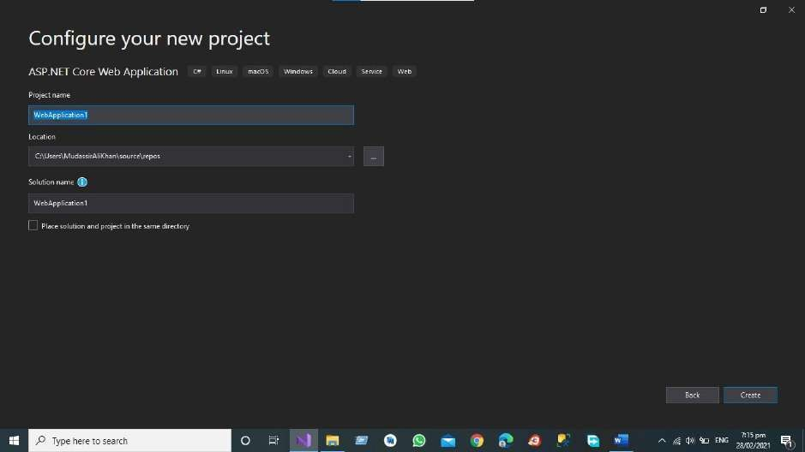
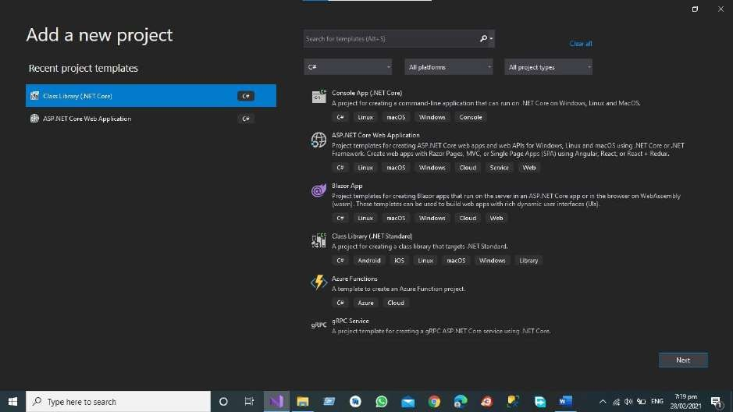
Step 2 Add the New Project in your Solution like Asp.net Core Class Library for Business
Access Layer and Data Access Layer
API Development Using Asp.NET Core Web API

Slide 25
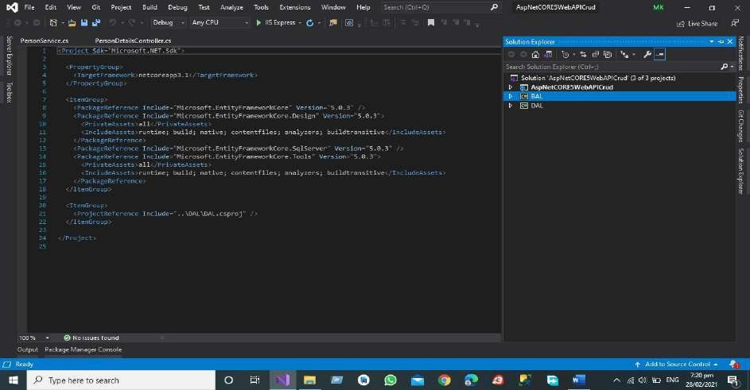
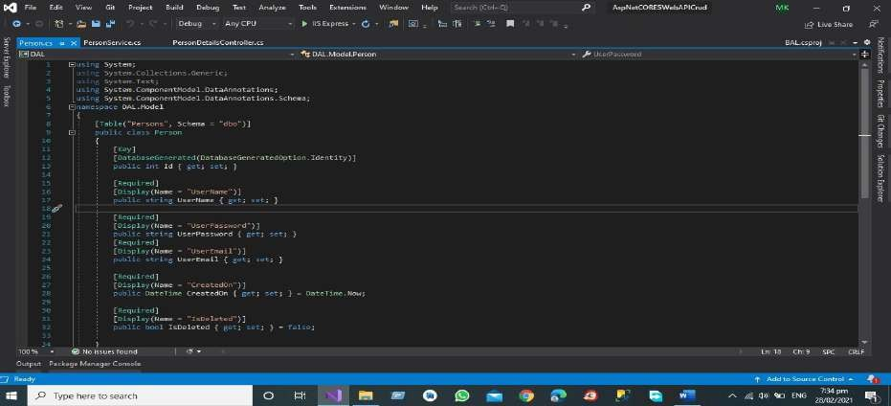
After Adding the BAL (Business Access Layer) And DAL (Data Access Layer)
All the Data in Data Access Layer and All the Crud Operations are in Data Access Layer for Business Logic we have Business Access layer in which we will do our All Operations Related to our Business.
Data Access Layer
The Given below picture is the structure of our project according to the Our Initial steps.
Step 3 First, Add the Model Person in the Data Access Layer
API Development Using Asp.NET Core Web API

Slide 26
Code is Given Below
using System;
using System.Collections.Generic; using System.Text;
using System.ComponentModel.DataAnnotations;
using System.ComponentModel.DataAnnotations.Schema; namespace DAL.Model
{
[Table("Persons", Schema = "dbo")] public class Person
{
[Key] [DatabaseGenerated(DatabaseGeneratedOption.Identity)] public int Id { get; set; }
[Required]
[Display(Name = "UserName")]
public string UserName { get; set; } [Required]
[Display(Name = "UserPassword")]
public string UserPassword { get; set; } [Required]
[Display(Name = "UserEmail")]
public string UserEmail { get; set; }
[Required]
[Display(Name = "CreatedOn")]
public DateTime CreatedOn { get; set; } = DateTime.Now;
[Required]
[Display(Name = "IsDeleted")]
public bool IsDeleted { get; set; } = false;
}
}
API Development Using Asp.NET Core Web API

Slide 27
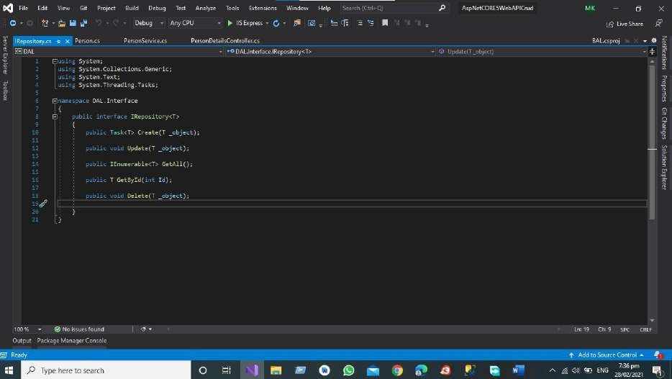
Step 4 Add the Enter face for all the operation you want to perform.
Code is Giver Below
using System;
using System.Collections.Generic; using System.Text;
using System.Threading.Tasks;
namespace DAL.Interface
{
public interface IRepository<T>
{
public Task<T> Create(T _object); public void Update(T _object); public IEnumerable<T> GetAll(); public T GetById(int Id);
public void Delete(T _object);
}
}
API Development Using Asp.NET Core Web API

Slide 28
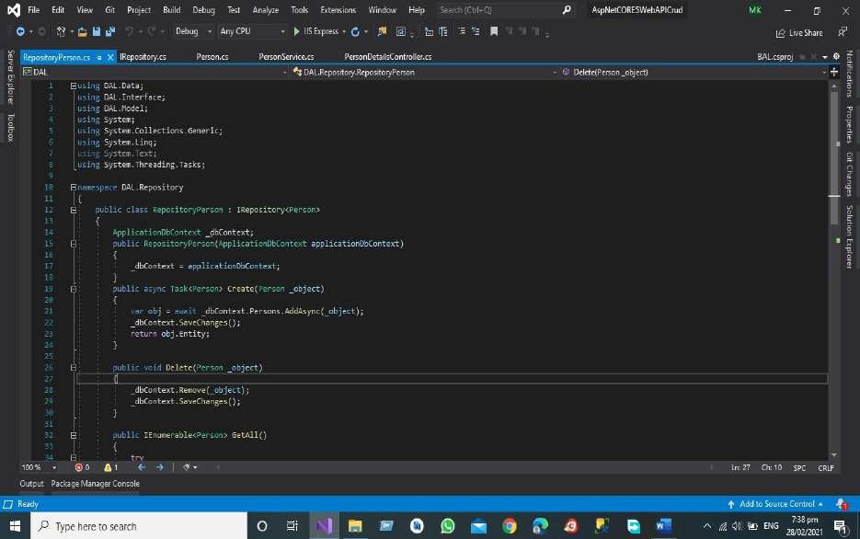
Step 5 Apply the Repository Pattern in you project Add the Class Repository Person.
Code is Given Below
using DAL.Data; using DAL.Interface; using DAL.Model; using System; using System.Collections.Generic; using System.Linq;
using System.Text;
using System.Threading.Tasks; namespace DAL.Repository
{
public class RepositoryPerson : IRepository<Person>
{
ApplicationDbContext _dbContext;
public RepositoryPerson(ApplicationDbContext applicationDbContext)
{
_dbContext = applicationDbContext;
API Development Using Asp.NET Core Web API

Slide 29
}
public async Task<Person> Create(Person _object)
{
var obj = await _dbContext.Persons.AddAsync(_object);
_dbContext.SaveChanges(); return obj.Entity;
}
public void Delete(Person _object)
{
_dbContext.Remove(_object);
_dbContext.SaveChanges();
}
public IEnumerable<Person> GetAll()
{
try
{
}
return _dbContext.Persons.Where(x => x.IsDeleted == false).ToList(); catch (Exception ee)
{
throw;
}
}
public Person GetById(int Id)
{
return _dbContext.Persons.Where(x => x.IsDeleted == false && x.Id == Id).FirstOrDefault();
}
API Development Using Asp.NET Core Web API

Slide 30
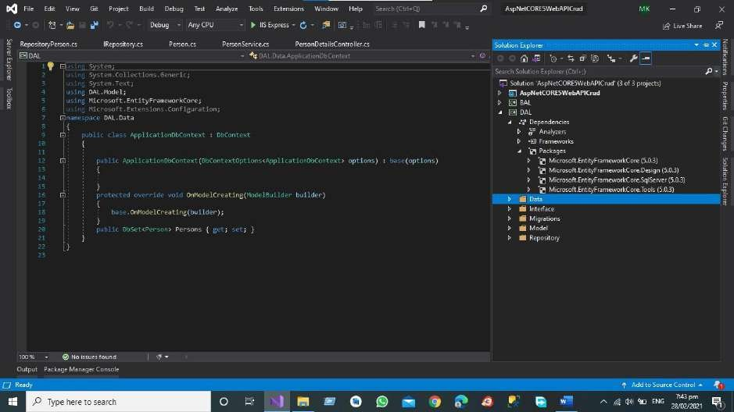
public void Update(Person _object)
{
_dbContext.Persons.Update(_object);
_dbContext.SaveChanges();
}
}
Step 6
Add the Data Folder and then add the Db Context Class set the database connection using SQL Server before starting the migration check these four packages in All of Your Project
API Development Using Asp.NET Core Web API

Slide 31
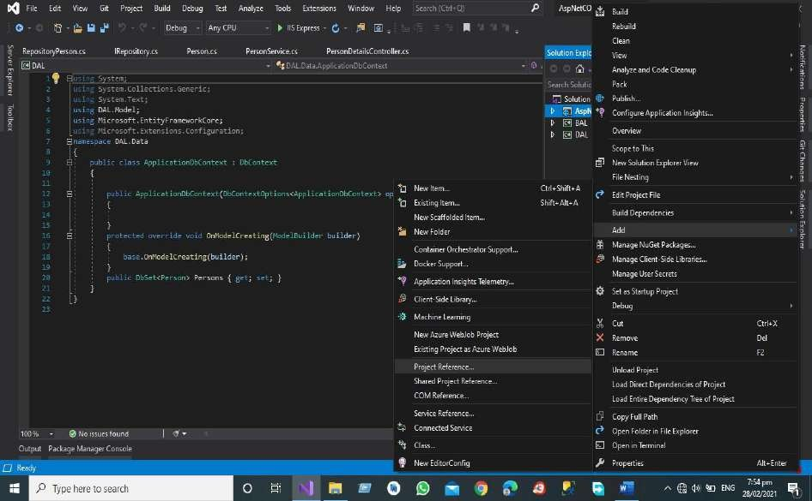
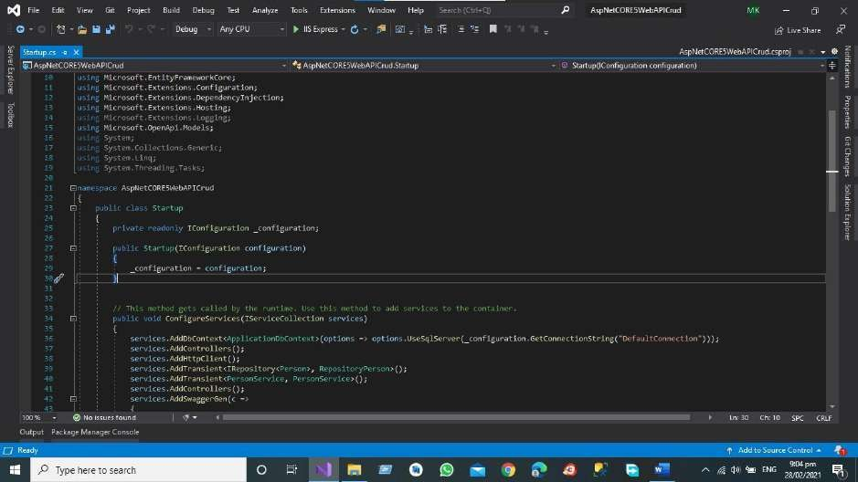
Then Add the project references in All of Project Directory Like in API Project and BAL Project
Like
Now Modify the Start-up Class in Project Solution.
API Development Using Asp.NET Core Web API

Slide 32
Code of the start-up file is given below
using BAL.Service; using DAL.Data;
using DAL.Interface; using DAL.Model;
using DAL.Repository;
using Microsoft.AspNetCore.Builder;
using Microsoft.AspNetCore.Hosting;
using Microsoft.AspNetCore.HttpsPolicy; using Microsoft.AspNetCore.Mvc;
using Microsoft.EntityFrameworkCore;
using Microsoft.Extensions.Configuration;
using Microsoft.Extensions.DependencyInjection; using Microsoft.Extensions.Hosting;
using Microsoft.Extensions.Logging; using Microsoft.OpenApi.Models;
using System;
using System.Collections.Generic; using System.Linq;
using System.Threading.Tasks; namespace AspNetCORE5WebAPICrud
{
public class Startup
{
private readonly IConfiguration _configuration;
public Startup(IConfiguration configuration)
{
_configuration = configuration;
}
API Development Using Asp.NET Core Web API

Slide 33
// This method gets called by the runtime. Use this method to add services to the container.
public void ConfigureServices(IServiceCollection services)
{
services.AddDbContext<ApplicationDbContext>(options options.UseSqlServer(_configuration.GetConnectionString("DefaultConnection")));
=>
services.AddControllers(
);
services.AddHttpClient()
;
services.AddTransient<IRepository<Person>,RepositoryPerson>(); services.AddTransient<PersonService,PersonService>(); services.AddControllers();
services.AddSwaggerGen(c =>
{
c.SwaggerDoc("v1", new OpenApiInfo { Title = "AspNetCORE5WebAPICrud", Version = "v1" });
});
}
// This method gets called by the runtime. Use this method to configure the HTTP request pipeline.
public void Configure(IApplicationBuilder app, IWebHostEnvironment env)
{
if (env.IsDevelopment())
{
app.UseDeveloperExceptionPage(); app.UseSwagger();
API Development Using Asp.NET Core Web API

Slide 34
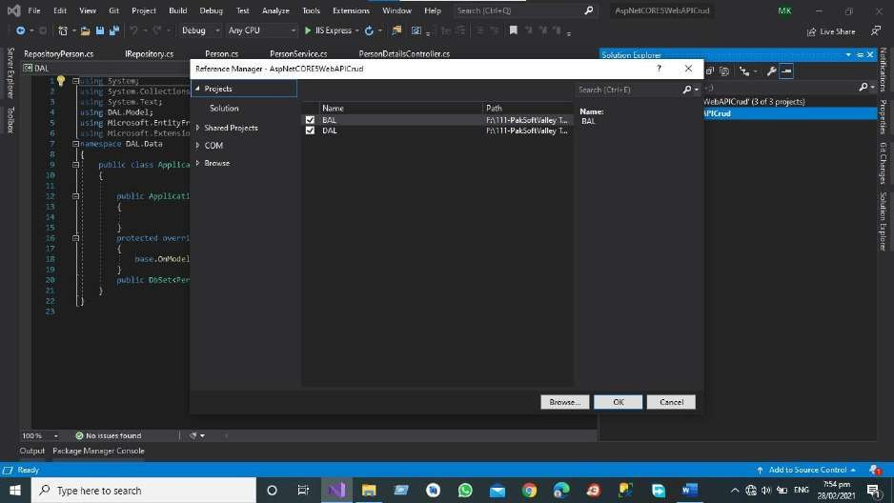
app.UseSwaggerUI(c => c.SwaggerEndpoint("/swagger/v1/swagger.json", "AspNetCORE5WebAPICrud v1"));
}
app.UseHttpsRedirection(
); app.UseRouting(); app.UseAuthorization();
app.UseEndpoints(endpoints =>
{
endpoints.MapControllers();
});
}
}
}
Then Add the DB Set Property in your Application Db Context Class.
API Development Using Asp.NET Core Web API

Slide 35
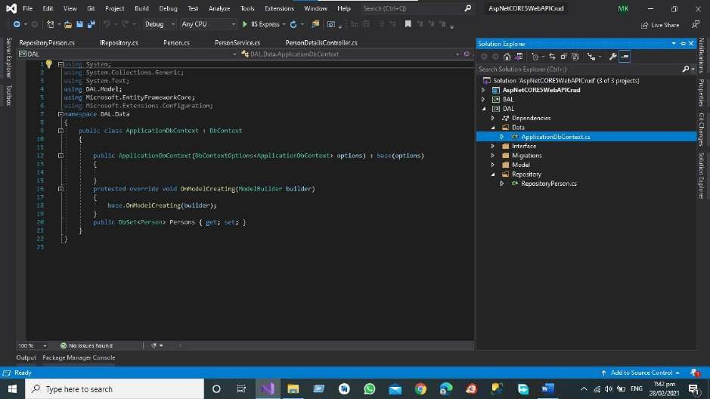
Code of Db Context Class is Given Below
using System;
using System.Collections.Generic; using System.Text;
using DAL.Model;
using Microsoft.EntityFrameworkCore; using Microsoft.Extensions.Configuration; namespace DAL.Data
{
public class ApplicationDbContext : DbContext
{
public base(options)
{
ApplicationDbContext(DbContextOptions<ApplicationDbContext> options) :
}
protected override void OnModelCreating(ModelBuilder builder)
{
base.OnModelCreating(builder);
}
public DbSet<Person> Persons { get; set; }
}
API Development Using Asp.NET Core Web API

Slide 36
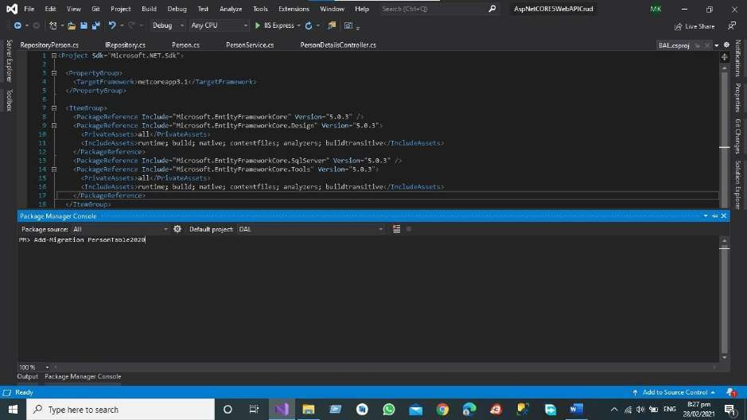
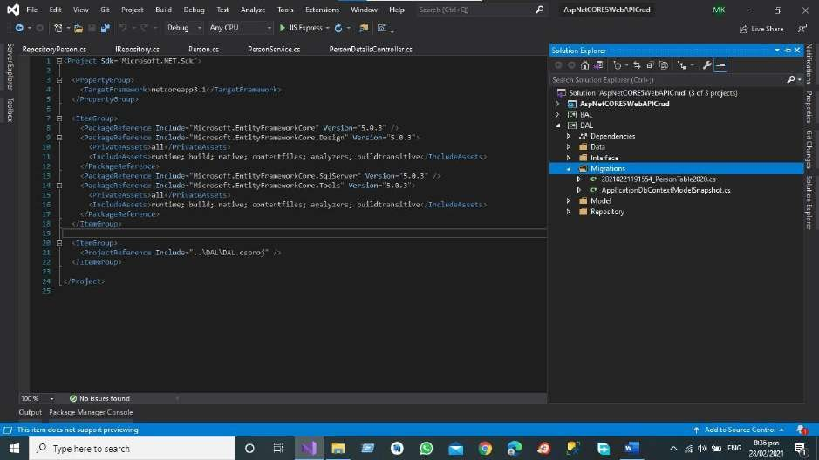
}
Step 7 Now start the migration Command for Creating the Table in Database.
After Executing the command, we have the migration folder in our Data Access Layer that contain the Definition of Person Table
API Development Using Asp.NET Core Web API

Slide 37
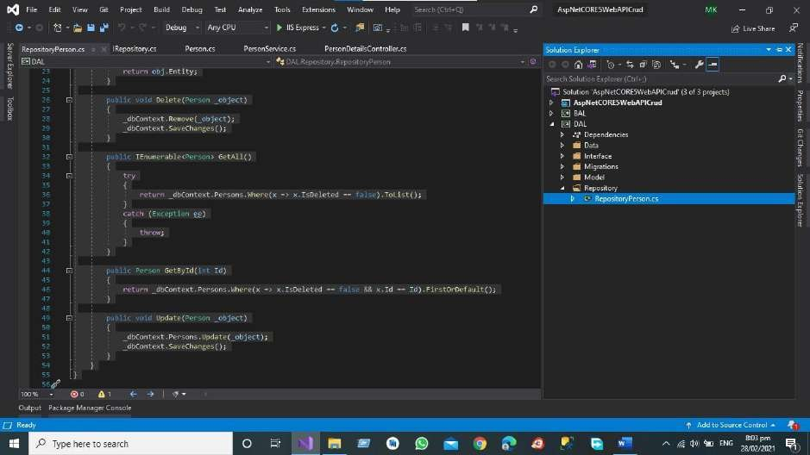
Step 8 Add the Repository Person class then Implement the Interface and Perform the suitable
Action according to the action define in Interface.
Code ID Given Below.
using DAL.Data;
using DAL.Interface; using DAL.Model; using System;
using System.Collections.Generic; using System.Linq;
using System.Text;
using System.Threading.Tasks;
namespace DAL.Repository
{
public class RepositoryPerson : IRepository<Person>
{
ApplicationDbContext _dbContext;
public RepositoryPerson(ApplicationDbContext applicationDbContext)
{
_dbContext = applicationDbContext;
}
API Development Using Asp.NET Core Web API

Slide 38
public async Task<Person> Create(Person _object)
{
var obj = await _dbContext.Persons.AddAsync(_object);
_dbContext.SaveChanges(); return obj.Entity;
}
public void Delete(Person _object)
{
_dbContext.Remove(_object);
_dbContext.SaveChanges();
}
public IEnumerable<Person> GetAll()
{
try
{
return _dbContext.Persons.Where(x => x.IsDeleted == false).ToList();
}
catch (Exception ee)
{
throw;
}
}
public Person GetById(int Id)
{
return Id).FirstOrDefault();
_dbContext.Persons.Where(x => x.IsDeleted == false && x.Id ==
}
public void Update(Person _object)
{
_dbContext.Persons.Update(_object);
_dbContext.SaveChanges();
API Development Using Asp.NET Core Web API

Slide 39
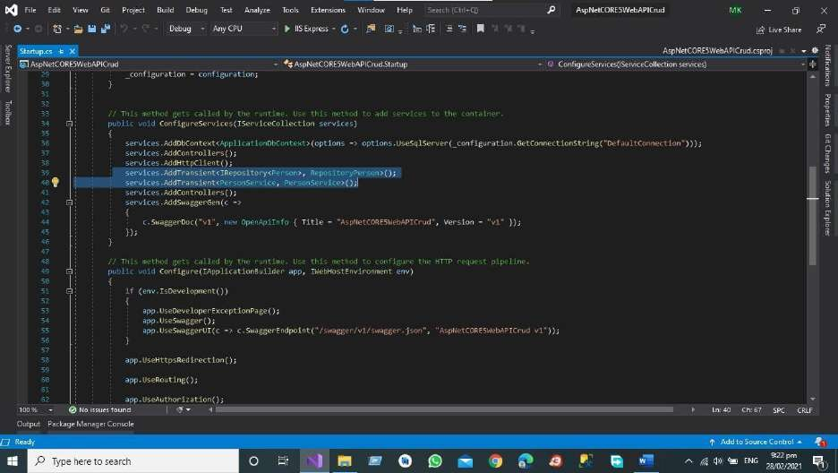
}
}
}
Step 10
Again, Modify the Start Up Class for Adding Transient to register the service business Layer and Data Access Layers Classes.
Code of the Start-up is given below.
using BAL.Service; using DAL.Data; using DAL.Interface; using DAL.Model;
using DAL.Repository;
using Microsoft.AspNetCore.Builder; using Microsoft.AspNetCore.Hosting;
using Microsoft.AspNetCore.HttpsPolicy; using Microsoft.AspNetCore.Mvc;
API Development Using Asp.NET Core Web API

Slide 40
using Microsoft.EntityFrameworkCore;
using Microsoft.Extensions.Configuration; using Microsoft.Extensions.DependencyInjection; using Microsoft.Extensions.Hosting;
using Microsoft.Extensions.Logging; using Microsoft.OpenApi.Models;
using System;
using System.Collections.Generic; using System.Linq;
using System.Threading.Tasks;
namespace AspNetCORE5WebAPICrud
{
public class Startup
{
private readonly IConfiguration _configuration;
public Startup(IConfiguration configuration)
{
_configuration = configuration;
}
// This method gets called by the runtime. Use this method to add services to the container.
public void ConfigureServices(IServiceCollection services)
{
services.AddDbContext<ApplicationDbContext>(options options.UseSqlServer(_configuration.GetConnectionString("DefaultConnection")));
services.AddControllers(); services.AddHttpClient();
=>
services.AddTransient<IRepository<Person>, RepositoryPerson>(); services.AddTransient<PersonService, PersonService>(); services.AddControllers();
services.AddSwaggerGen(c =>
{
API Development Using Asp.NET Core Web API

Slide 41
c.SwaggerDoc("v1", new OpenApiInfo { Title = "AspNetCORE5WebAPICrud", Version
= "v1" });
});
}
// This method gets called by the runtime. Use this method to configure the HTTP request pipeline.
public void Configure(IApplicationBuilder app, IWebHostEnvironment env)
{
if (env.IsDevelopment())
{
app.UseDeveloperExceptionPage(); app.UseSwagger();
app.UseSwaggerUI(c "AspNetCORE5WebAPICrud v1"));
}
=>
c.SwaggerEndpoint("/swagger/v1/swagger.json",
app.UseHttpsRedirection();
app.UseRouting(); app.UseAuthorization();
app.UseEndpoints(endpoints =>
{
endpoints.MapControllers();
});
}
}
}
API Development Using Asp.NET Core Web API

Slide 42
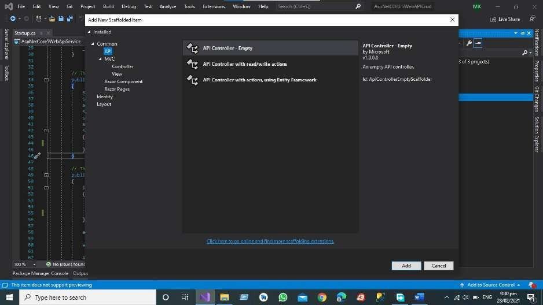
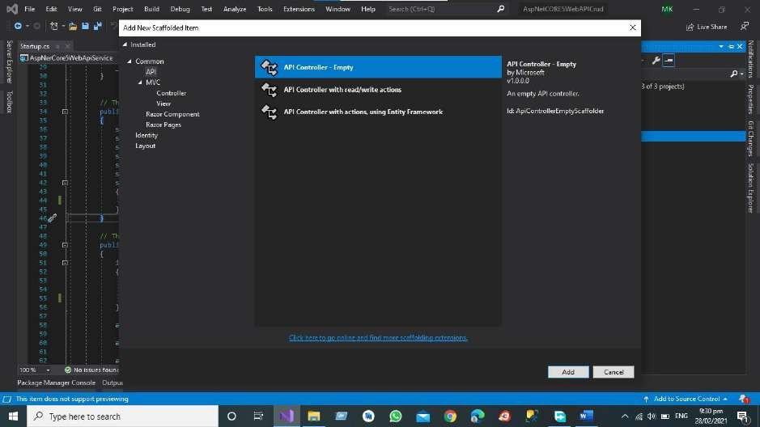
Step 11
Add the Person Details API Controller for GET PUT POST AND DELETE end points
API Development Using Asp.NET Core Web API

Slide 43
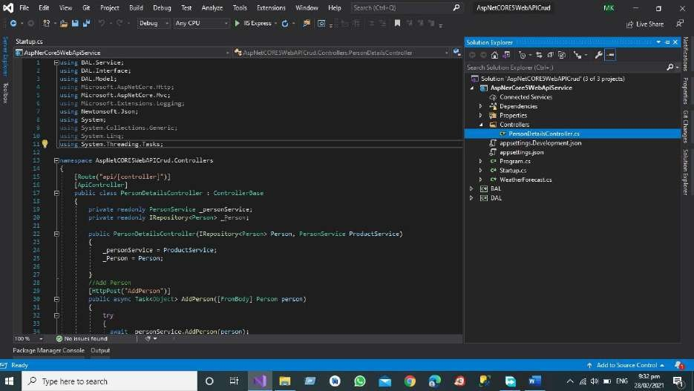
After Adding the Controller in the API project
Code of the Controller for Person Details is Given Below
using BAL.Service; using DAL.Interface; using DAL.Model;
using Microsoft.AspNetCore.Http;
using Microsoft.AspNetCore.Mvc; using Microsoft.Extensions.Logging; using Newtonsoft.Json;
using System;
using System.Collections.Generic; using System.Linq;
using System.Threading.Tasks;
namespace AspNetCORE5WebAPICrud.Controllers
{
[Route("api/[controller]")] [ApiController]
public class PersonDetailsController : ControllerBase
{
private readonly PersonService _personService; private readonly IRepository<Person> _Person;
public PersonDetailsController(IRepository<Person> Person, PersonService ProductService)
{
_personService = ProductService;
_Person = Person;
API Development Using Asp.NET Core Web API

Slide 44
}
//Add Person [HttpPost("AddPerson")]
public async Task<Object> AddPerson([FromBody] Person person)
{
try
{
await _personService.AddPerson(person); return true;
}
catch (Exception)
{
return false;
}
}
//Delete Person [HttpDelete("DeletePerson")]
public bool DeletePerson([FromBody] String UserEmail)
{
try
{
}
_personService.DeletePerson(UserEmail); return true; catch (Exception)
{
return false;
}
}
//Delete Person [HttpPut("UpdatePerson")]
public bool UpdatePerson([FromBody] String UserEmail)
{
try
{
}
_personService.UpdatePerson(UserEmail); return true; catch (Exception)
{
return false;
}
}
API Development Using Asp.NET Core Web API

Slide 45
//GET All Person by Name [HttpGet("GetAllPersonByName")] public Object GetAllPersonByName(string UserEmail)
{
var data = _personService.GetPersonByUserName(UserEmail);
var json = JsonConvert.SerializeObject(data, Formatting.Indented, new JsonSerializerSettings()
{
ReferenceLoopHandling = Newtonsoft.Json.ReferenceLoopHandling.Ignore
}
);
return json;
}
//GET All Person [HttpGet("GetAllPersons")] public Object GetAllPersons()
{
var data = _personService.GetAllPersons();
var json = JsonConvert.SerializeObject(data, Formatting.Indented,
new JsonSerializerSettings()
{
ReferenceLoopHandling = Newtonsoft.Json.ReferenceLoopHandling.Ignore
}
);
return json;
}
}
}
RESTful Web Service Results
To get the results of APIS We need to start the visual studio debugging process and then using swagger API Testing we will test all end points of Project.
Debug the project using visual studio
Swagger is Already Implemented in Our Project for Documenting the web service in this Project
We have Separate Endpoints for GET POST DELETE AND PUT
API Development Using Asp.NET Core Web API

Slide 46
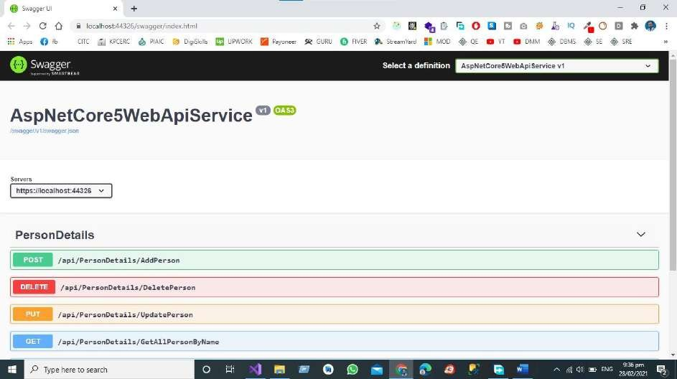
For Add the Person we have Add Person End Point that give us the JSON Object for sending the Complete JSON Object in the Database.
POST Endpoint in Web API Service
If we want to Create the New Person in the Database, we must send the JSON Object to the End
Point then data is posted by Swagger UI to POST End Point in the Controller Then Create Person Object Creates the Complete Person Object in the Database.
API Development Using Asp.NET Core Web API

Slide 47
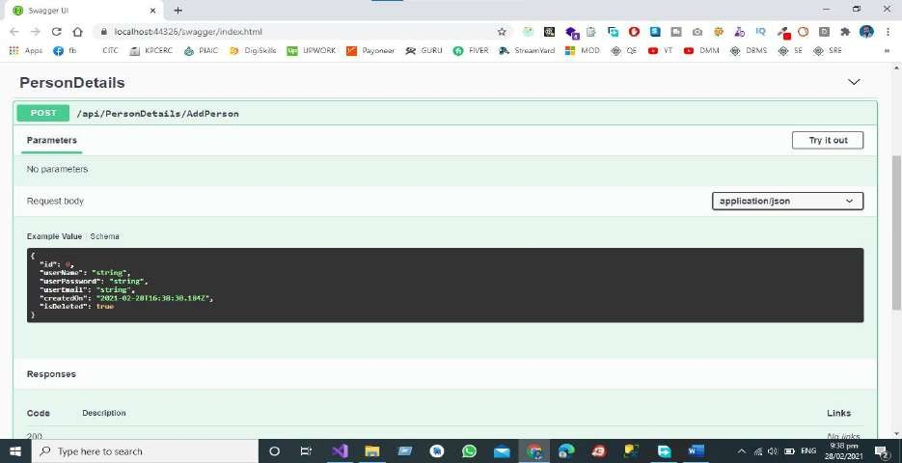
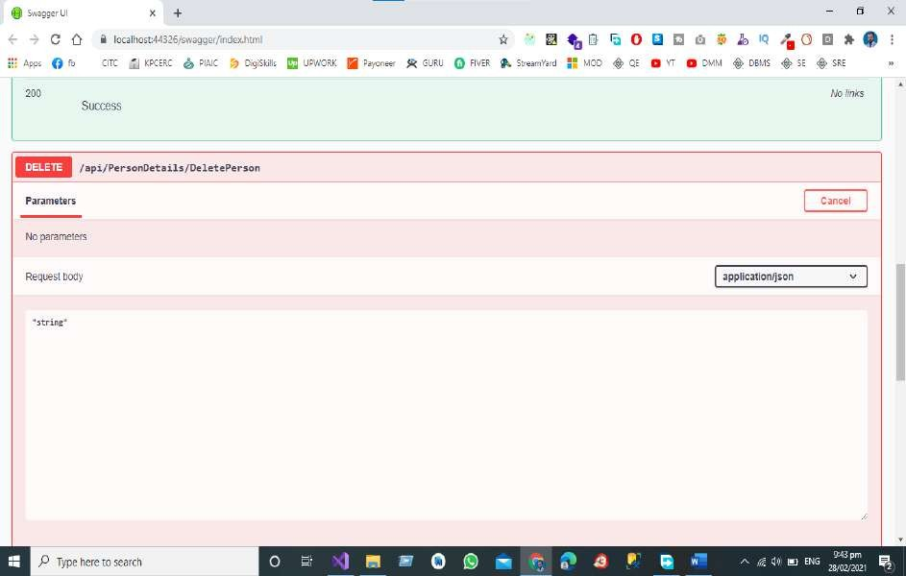
DELETE Endpoint in Web API Service
For deletion of person, we have a separate end point delete employee from the database, we must
send the JSON object to the end point then data is posted by swagger UI to call the end point delete person in the controller then person object will be deleted from the database.
API Development Using Asp.NET Core Web API

Slide 48
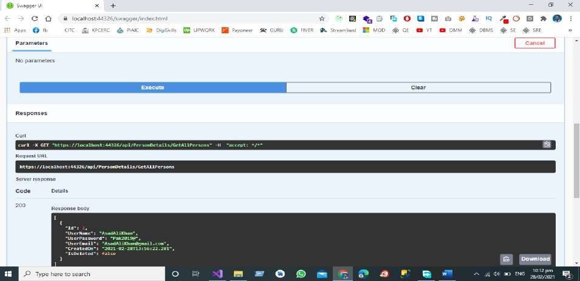
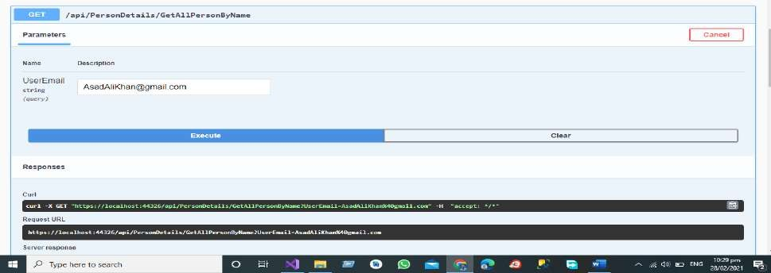
GET All Endpoint in Web API Service
We have Separate End Points for All the operations like Get All the Person Records from the
Database by Hitting the GET End Point that send the request to controller and in controller we have the separate End Point for Fetching all the record from the database.
GET End Point for Getting the Record by User Email
We have Separate End Points for All the operations like Get the Record of the Person by User Email from the Database by Hitting the GET End Point that send the request to controller and in
controller we have the separate End Point for Fetching the record based on User Email from the database.
API Development Using Asp.NET Core Web API

Slide 49
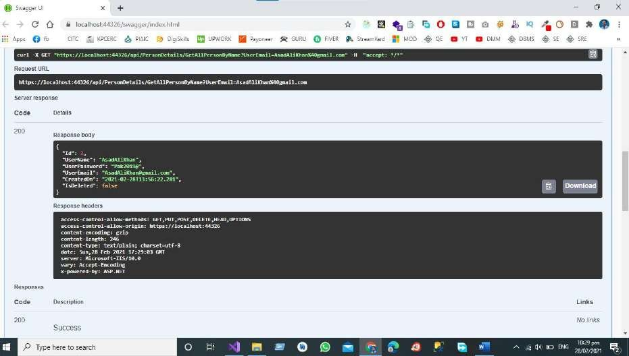
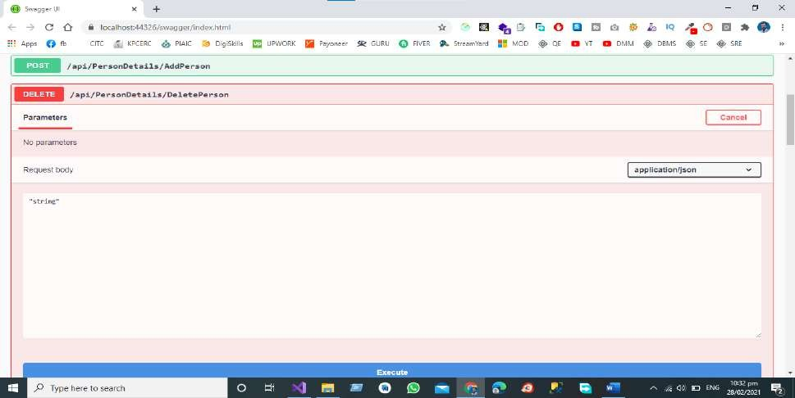
Delete End Point for Deleting the Record by User Email
We have Separate End Points for All the operations like Delete the Record of the Person by User Email from the Database by Hitting the DELETE End Point that send the request to controller and
in controller we have the separate End Point for Deleting the record based on User Email from the database.
API Development Using Asp.NET Core Web API

Slide 50
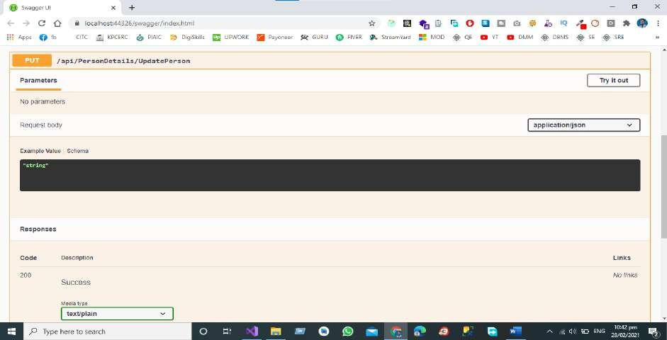
Update End Point for Updating the Record by User Email
We have Separate End Points for All the operations like Update the Record of the Person by User Email from the Database by Hitting the UPDTAE End Point that send the request to controller
and in controller we have the separate End Point for Updating the record based on User Email from the database.
Testing the RESTful Web Service
Test the project using visual studio for that we need to follow given below steps
Step 1 Run the Project
Run the project then in the browser Swagger UI will be shown to the Tester
API Development Using Asp.NET Core Web API

Slide 51
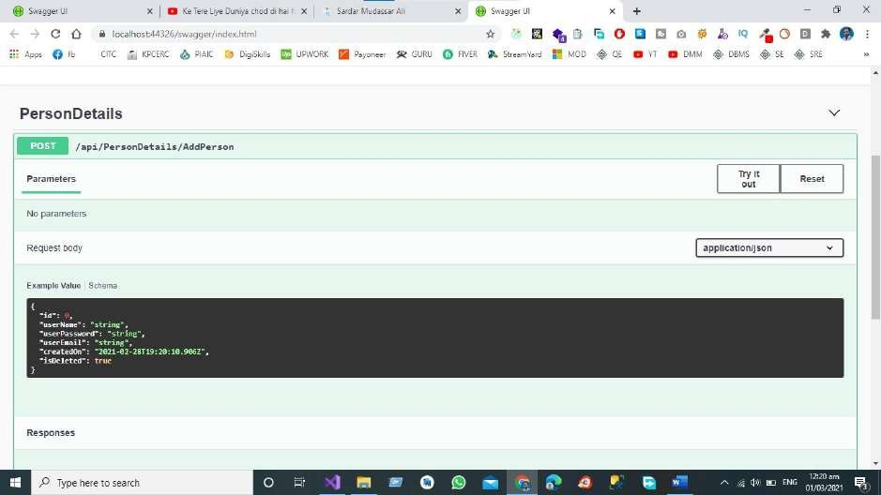
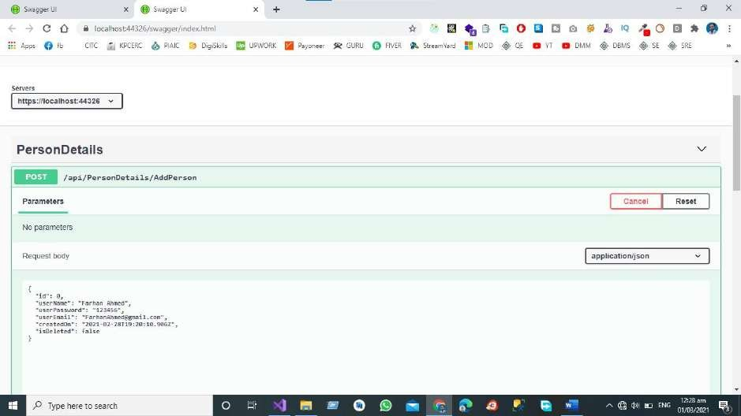
Step 2 Test POST End Point
Now Click on Try Out Button then and then send the JSON Object to the Add Person End Point that is already Define in Our Controller.
API Development Using Asp.NET Core Web API

Slide 52
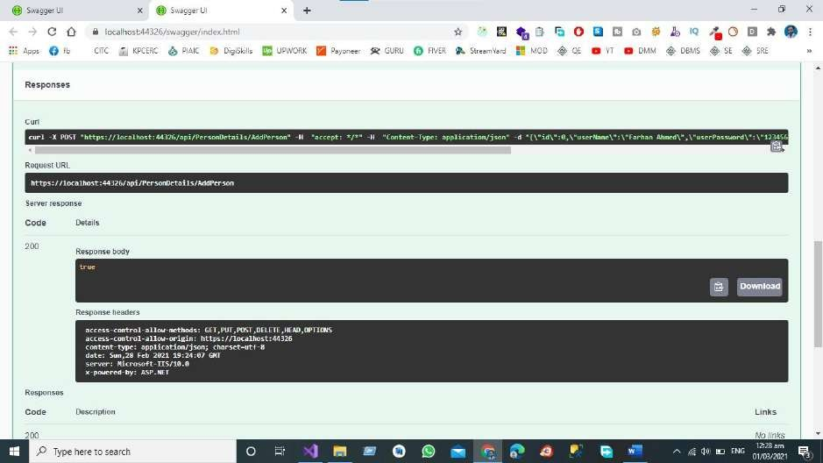
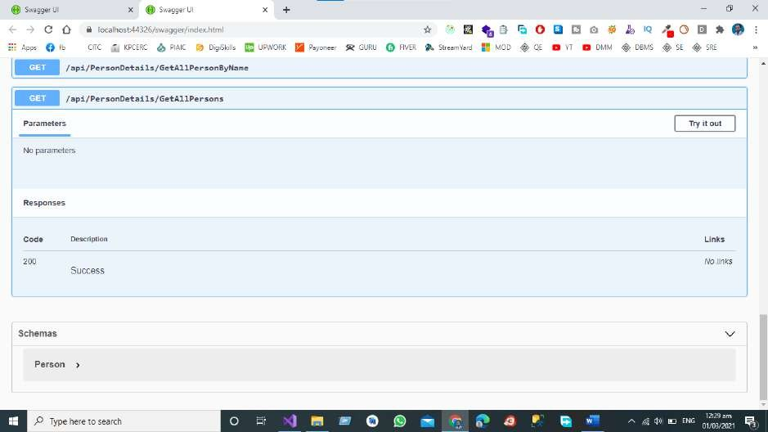
We have sent the JSON Object to the End Point of API as shown in the figure and the Response Body for this call is true means that our One Object is Created in in Database.
Step 3 Test GET End Point
API Development Using Asp.NET Core Web API

Slide 53
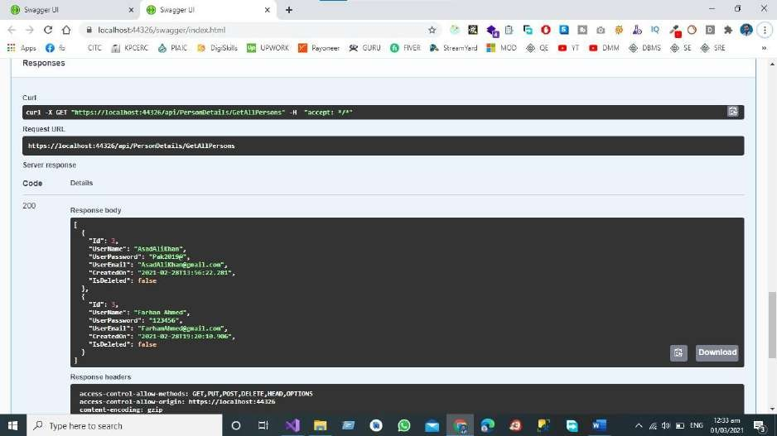
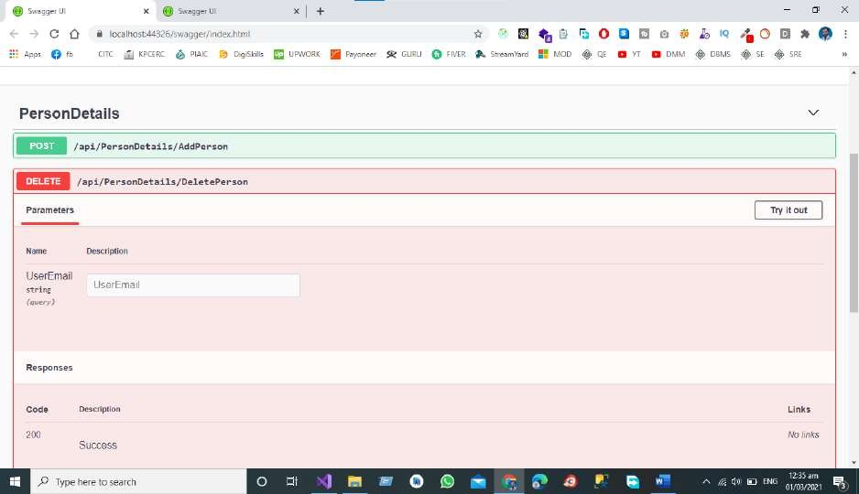
Click the Tryout Button to get the Get All Record.
API Development Using Asp.NET Core Web API

Slide 54
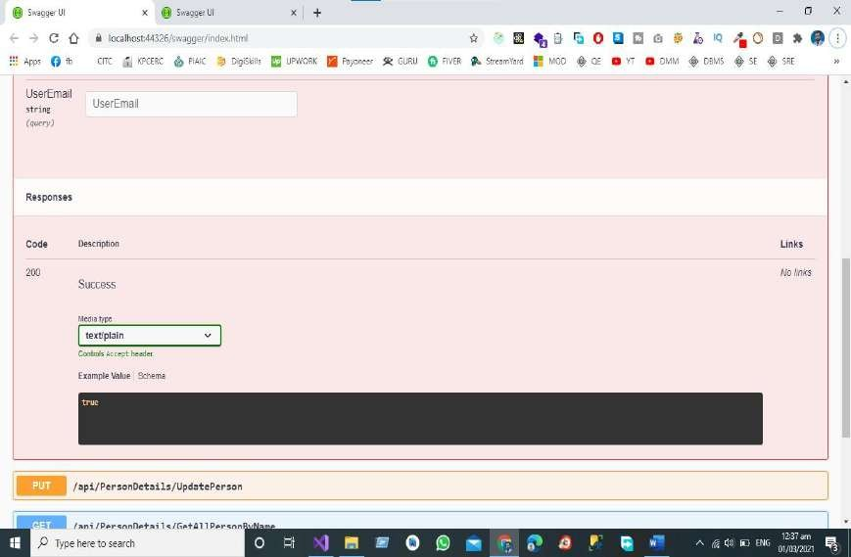
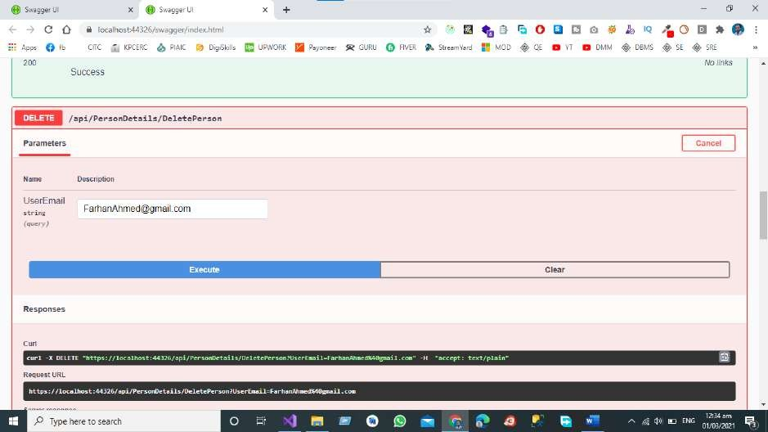
Step 4 Test DELETE End Point
Now Click on Try Out Button then and then send the JSON Object to the Delete End Point that is already Define in Our Controller.
We have sent the User Email to the End Point of API as shown in the figure and the Response Body for this call is true means that our One Object is Deleted in in Database.
API Development Using Asp.NET Core Web API

Slide 55
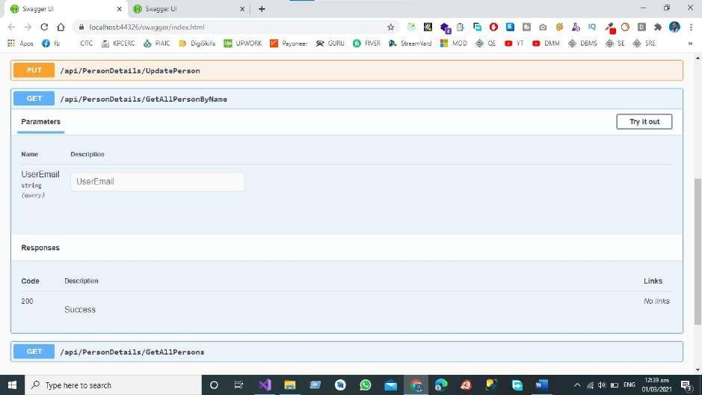
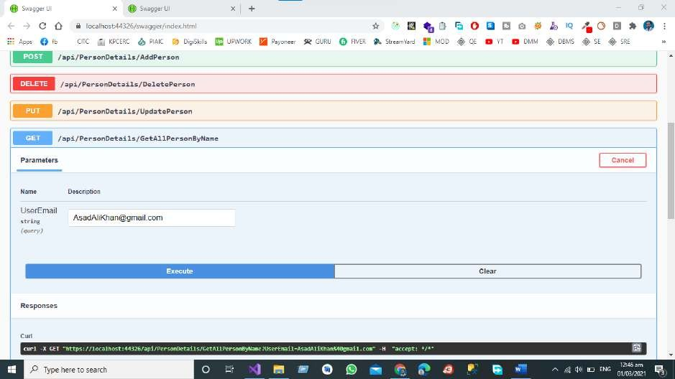
Step 5 Test GET by User Email End
Point
Now Click on Try Out Button then and then send the JSON Object to the GET End Point that is
already Define in Our Controller for getting Record on the bases of Person Email.
API Development Using Asp.NET Core Web API

Slide 56
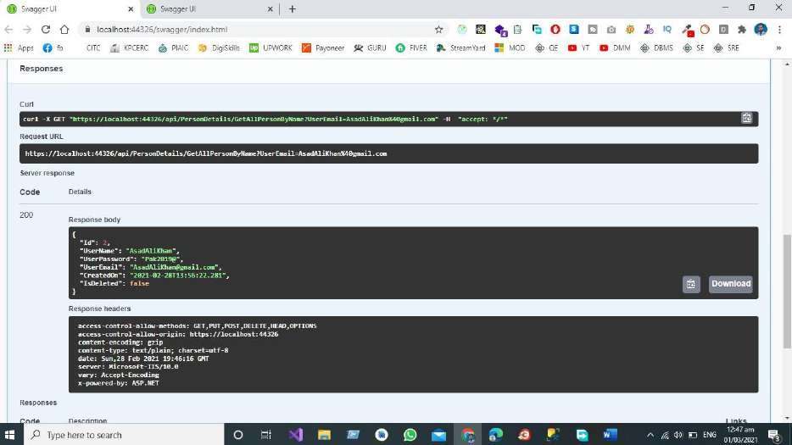
We get the Data from the Database According to the User Gmail Id
Conclusion
As a Software Engineer My Opinion about Restful web services are a lightweight maintainable and
scalable service that is built on the REST Architecture. Restful Web service exposes API from your application in a secure uniform stateless manner to the calling client can perform predefined operations using the restful service the protocols for the REST is HTTP and Rest is a Representational State Transfer. Representational state transfer (REST) is a de-facto standard for a software Architecture or Interactive applications that use Web Service a Web Service that follows this standard is called RESTful such web must provide its web resources in a textual representation and allow them to be read and modified with stateless protocol and predefined set of operations this standard allow interoperability between a Machine and the Internet that provide these services. REST Architecture is alternative to SOAP and SOAP Architecture is the way to access a Web Service.
Complete Git Hub Project URL
Click here for complete project access
API Development Using Asp.NET Core Web API

Slide 57
Chapter 2 – API Development in Asp.Net Core Using Three Tier Architecture
Introduction
Project Structure
Presentation Layer (PL)
Business Access Layer (BAL)
Data Access Layer (DAL)
Add the References to the Project
Data Access Layer
Contacts
Data
Migrations
Models
Repository
Business Access Layer
Services
Presentation layer
Advantages of 3-Tier Architecture
Dis-Advantages of 3-Tier Architecture
Conclusion
Complete GitHub Project URL

Slide 58
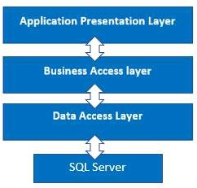
Introduction
In this chapter, we'll look at three-tier architecture and how to incorporate the Data Access Layer and Business Access Layer into a project, as well as how these layers interact.
Project Structure
We use a three-tier architecture in this project, with a data access layer, a business access layer, and an application presentation layer.
Presentation Layer (PL)
The Presentation layer is the top-most layer of the 3-tier architecture, and its major role is to
display the results to the user, or to put it another way, to present the data that we acquire from the business access layer and offer the results to the front-end user.
Business Access Layer (BAL)
The logic layer interacts with the data access layer and the presentation layer to process the
activities that lead to logical decisions and assessments. This layer's primary job is to process data between other layers.
Data Access Layer (DAL)
The main function of this layer is to access and store the data from the database and the process
of the data to business access layer data goes to the presentation layer against user request.

Slide 59
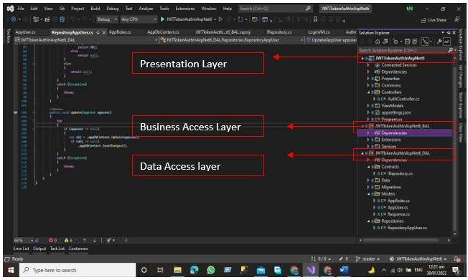
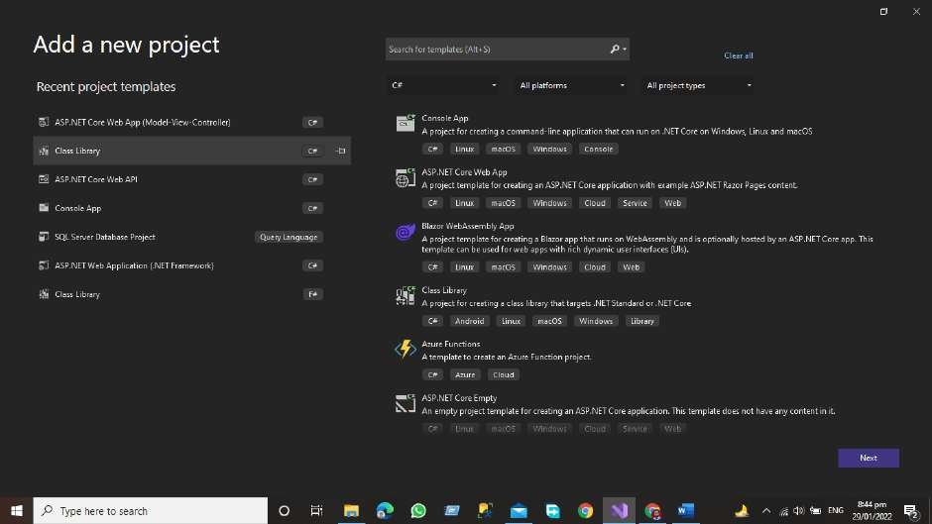
Steps to Follow for configuring these layer
Add the Class Library project of Asp.net for Data Access Layer
Right Click on the project and then go to the add the new project window and then add the Asp.net Core class library project.

Slide 60
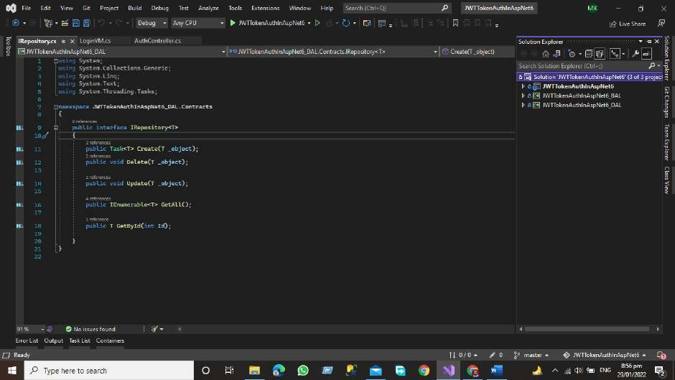
After Adding the Data Access layer project now, we will add the Business access layer folder
Add the Class library project of Asp.Net Core for Business Access
Right Click on the project and then go to the add the new project window and then add the Asp.net Core class library project.
After adding the business access layer and data access layer, we must first add the references of the Data Access layer and Business Access layer, so that the project structure can be seen.

Slide 61

As you can see, our project now has a Presentation layer, Data Access Layer, and Business Access layer.
Add the References to the Project
Now, in the Presentation Layer, add the references to the Data Access Layer and the Business Access Layer.
Right Click on the Presentation layer and then click on add => project Reference
Add the References by Checking both the checkboxes

Slide 62


References have been added for both DAL and BAL
Now we'll add the Data Access layer project references to the Business layer.
Right Click on the Business access layer and then Click Add Button => Project References

Slide 63


“Remember that we have included the DAL and BAL references in the project, so don't add the Presentation layer references again in the business layer. We only need the DAL Layer references in the business layer”

Slide 64

Project References of DAL Has Been Added to BAL Layer
Data Access Layer
The Data Access Layer contains methods that assist the Business Access Layer in writing
business logic, whether the functions are linked to accessing or manipulating data. The Data Access Layer's major goal is to interface with the database and the Business Access Layer in our project.
the structure will be like this.
In this Layer we have the Following Folders Add these folders to your Data access layer
Contacts
Data
Migrations
Models
Repositories
Contacts
In the Contract Folder, we define the interface that has the following function that performs the
desired functionalities with the database like
using System;

Slide 65

using System.Collections.Generic; using System. Linq;
using System. Text;
using System.Threading.Tasks;
namespace JWTTokenAuthInAspNet6_DAL.Contracts
{
public interface IRepository<T>
{
public Task<T> Create(T _object); public void Delete(T _object);
public void Update(T _object); public IEnumerable<T> GetAll(); public T GetById(int Id);
}
}

Slide 66

Data
In the Data folder, we have Db Context Class this class is very important for accessing the data
from the database.
Migrations
The Migration Folder contains information on all the migrations we performed during the
construction of this project. The Migration Folder contains information on all the migrations we performed during the construction of this project.
Models
Our application models, which contain domain-specific data, and business logic models, which
represent the structure of the data as public attributes, business logic, and methods, are stored in the Model folder.

Slide 67

using Microsoft.AspNetCore.Identity; using System;
using System.Collections.Generic; using System. Linq;
using System. Text;
using System.Threading.Tasks;
namespace JWTTokenAuthInAspNet6_DAL.Models
{
public class AppUser: IdentityUser
{
public int Id { get; set; }
public string? Name { get; set; }
public string? AccountType { get; set; } public string? PhoneNo { get; set; } public string? Password { get; set; } public string? ShopName { get; set; } public string? BusinessType { get; set; } public string? UserRole { get; set; } public bool? IsDeleted { get; set; }
}
}

Slide 68

Repository
In the Repository folder, we add the repository classes against each model. We write the CRUD
function that communicates with the database using the entity framework. We add the repository class that inherits our Interface that is present in our contract folder.
using JWTTokenAuthInAspNet6_DAL.Contracts; using JWTTokenAuthInAspNet6_DAL.Data; using JWTTokenAuthInAspNet6_DAL.Models; using Microsoft.Extensions.Logging;
using System;
using System.Collections.Generic; using System.Linq;
using System.Text;
using System.Threading.Tasks;
namespace JWTTokenAuthInAspNet6_DAL.Repositories
{
public class RepositoryAppUser : IRepository<AppUser>
{
private readonly AppDbContext _appDbContext; private readonly ILogger _logger;
public RepositoryAppUser(ILogger<AppUser> logger)
{
_logger = logger;
}

Slide 69
public async Task<AppUser> Create(AppUser appuser)
{
try
{
if (appuser != null)
{
var obj = _appDbContext.Add<AppUser>(appuser); await _appDbContext.SaveChangesAsync();
return obj.Entity;
}
else
{
return null;
}
}
catch (Exception)
{
throw;
}
}
public void Delete(AppUser appuser)
{
try
{
if(appuser!=null)
{
var obj = _appDbContext.Remove(appuser); if (obj!=null)
{
_appDbContext.SaveChangesAsync();
}
}
}
catch (Exception)
{
throw;
}
}
public IEnumerable<AppUser> GetAll()

Slide 70
{
try
{
var obj = _appDbContext.AppUsers.ToList(); if (obj != null)
return obj; else
return null;
}
catch (Exception)
{
throw;
}
}
public AppUser GetById(int Id)
{
try
{
if(Id!=null)
{
var Obj = _appDbContext.AppUsers.FirstOrDefault(x => x.Id == Id); if (Obj != null)
return Obj; else
return null;
}
else
{
return null;
}
}
catch (Exception)
{
throw;
}
}
public void Update(AppUser appuser)
{
try
{

Slide 71

if (appuser != null)
{
var obj = _appDbContext.Update(appuser); if (obj != null)
_appDbContext.SaveChanges();
}
}
catch (Exception)
{
throw;
}
}
}
}
Business Access Layer
The business layer communicates with the data access layer and the presentation layer logic
layer process the actions that make the logical decision and evaluations the main function of this layer is to process the data between surrounding layers.
Our Structure of the project in the Business Access Layer will be like this.
In this layer, we will have two folders
Extensions Method Folder
And Services Folder

Slide 72
In the business access layer, we have our services that communicate with the surrounding layers like the data layer and Presentation Layer.
Services
Services define the application's business logic. We develop services that interact with the data
layer and move data from the data layer to the presentation layer and from the presentation layer to the data access layer.
Example
using JWTTokenAuthInAspNet6_DAL.Contracts; using JWTTokenAuthInAspNet6_DAL.Models; using System;
using System.Collections.Generic; using System.Linq;
using System.Text;
using System.Threading.Tasks;
namespace JWTTokenAuthInAspNet6_BAL.Services
{
public class ServiceAppUser
{
public readonly IRepository<AppUser> _repository;
public ServiceAppUser(IRepository<AppUser> repository)
{
_repository = repository;
}
//Create Method
public async Task<AppUser> AddUser(AppUser appUser)
{
try
{
if (appUser == null)
{
throw new ArgumentNullException(nameof(appUser));
}
else
{
return await _repository.Create(appUser);
}
}
catch (Exception)

Slide 73
{
throw;
}
}
public void DeleteUser(int Id)
{
try
{
if (Id != 0)
{
var obj = _repository.GetAll().Where(x => x.Id == Id).FirstOrDefault();
_repository.Delete(obj);
}
}
catch (Exception)
{
throw;
}
}
public void UpdateUser(int Id)
{
try
{
if (Id != 0)
{
var obj = _repository.GetAll().Where(x => x.Id == Id).FirstOrDefault(); if (obj != null)
_repository.Update(obj);
}
}
catch (Exception)
{
throw;
}
}

Slide 74

public IEnumerable<AppUser> GetAllUser()
{
try
{
return _repository.GetAll().ToList();
}
catch (Exception)
{
throw;
}
}
}
}
Presentation layer
The top-most layer of the 3-Tier architecture is the Presentation layer the main function of this
layer is to give the results to the user or in simple words to present the data that we get from the business access layer and give the results to the front-end user.
In the presentation layer, we have the default template of the asp.net core application here OUR structure of the application will be like this.

Slide 75
The presentation layer is responsible to give the results to the user against every HTTP request. Here we have a controller that is responsible for handling the HTTP request and communicates with the business layer against each HTTP request get the get data from the associated layer and then present it to the User.
Advantages of 3-Tier Architecture
It makes the logical separation between the presentation layer, business layer, and data layer.
Migration to a new environment is fast.
In This Model, each tier is independent so we can set the different developers on each tier for the fast development of applications
Easy to maintain and understand the large-scale applications
The business layer is in between the presentation layer and data layer the application is more secured because the client will not have direct access to the database.
The process data that is sent from the business layer is validated at this level.
The Posted data from the presentation layer will be validated at the business layer before Inserting or Updating the Database
Database security can be provided at BAL Layer
Define the business logic one in the BAL Layer and then share it among the other components at the presentation layer
Easy to Apply for Object-oriented Concepts
Easy to update the data provided quires at DAL Layer
Dis-Advantages of 3-Tier Architecture
It takes a lot of time to build the small part of the application
Need Good understanding of Object-Oriented programming
Conclusion
In this chapter, we have learned about 3-tier Architecture and how the three-layer exchange
data between them how we can add the Data Access Layer and Business access layer in the project and studied how these layers communicate with each other.
Presentation Layer (PL)

Slide 76
The top-most layer of the 3-Tier architecture is the Presentation layer the main function of this layer is to give the results to the user or in simple words to present the data that we get from the business access layer and give the results to the front-end user.
Business Access Layer (BAL)
The logic layer communicates with the data access layer and the presentation layer logic layer process the actions that make the logical decision and evaluations the main function of this layer is to process the data between surrounding layers.
Data Access Layer (DAL)
The main function of this application is to access and store the data from the database and the process of the data to business access layer data goes to the presentation layer against user request.
Complete Git Hub Project URL
Click here for complete project access

Slide 77
Chapter 3- API Development in Asp.Net Using Onion Architecture
Introduction
What is Onion architecture
Layers in Onion Architecture
Domain Layer
Repository Layer
Service Layer
Presentation Layer
Advantages of Onion Architecture
Implementation of Onion Architecture
Project Structure.
Domain Layer
Models Folder
Data Folder
Repository Layer
Service Layer
I Custom Service
Custom Service
Department Service
Student Service
Result Service
Subject GPA Service
Presentation Layer
Dependency Injection
Modify Program.cs File
Controllers
Output
Conclusion

Slide 78

Introduction
In this chapter, we will cover the onion architecture using the Asp.Net 6 Web API. Onion
architecture term introduces by Jeffrey Palermo in 2008 this architecture provides us a better way to build applications using this architecture our applications are better testable maintainable and dependable on infrastructures like databases and services. Onion architecture solves common problems like coupling and separation of concerns.
What is Onion architecture
In onion architecture, we have the domain layer, repository layer, service layer, and
presentation layer. Onion architecture solves the problem that we face during the enterprise applications like coupling and separations of concerns. Onion architecture also solves the problem that we confronted in three-tier architecture and N-Layer architecture. In Onion architecture, our layer communicates with each other using interfaces.
Layers in Onion Architecture
Onion architecture uses the concept of the layer, but it is different from N-layer architecture and 3-Tier architecture.

Slide 79
Domain Layer
This layer lies in the center of the architecture where we have application entities which are the
application model classes or database model classes using the code first approach in the application development using Asp.net core these entities are used to create the tables in the database.
Repository Layer
The repository layer act as a middle layer between the service layer and model objects we will maintain all the database migrations and database context Object in this layer. We will add the
interfaces that consist the of data access pattern for reading and writing operations with the database.
Service Layer
This layer is used to communicate with the presentation and repository layer. The service layer holds all the business logic of the entity. In this layer services interfaces are kept separate from
their implementation for loose coupling and separation of concerns.
Presentation Layer
In the case of the API Presentation layer that presents us the object data from the database using
the HTTP request in the form of JSON Object. But in the case of front-end applications, we present the data using the UI by consuming the APIS.
Advantages of Onion Architecture
Onion architecture provides us with the batter maintainability of code because code depends on layers.
It provides us batter testability for unit tests we can write the separate test cases in layers without affecting the other module in the application.
Using the onion architecture our application is loosely coupled because our layers communicate with each other using the interface.
Domain entities are the core and center of the architecture and have access to databases and UI Layer.
A Complete implementation would be provided to the application at run time.
The external layer never depends on the external layer.

Slide 80

Implementation of Onion Architecture
Now we are going to develop the project using the Onion Architecture
First, you need to create the Asp.net Core web API project using visual studio. After creating the project, we will add our layer to the project after adding all the layers our project structure will look like this.
Project Structure.
Domain Layer
This layer lies in the center of the architecture where we have application entities which are the
application model classes or database model classes using the code first approach in the application development using Asp.net core these entities are used to create the tables in the database.
For the Domain layer, we need to add the library project to our application. Write click on the Solution and then click on add option.

Slide 81


Add the library project to your solution
Name this project as Domain Layer

Slide 82

Models Folder
First, you need to add the Models folder that will be used to create the database entities. In the
Models folder, we will create the following database entities.
Base Entity
using System;
using System.Collections.Generic; using System.Linq;
using System.Text;
using System.Threading.Tasks;
namespace DomainLayer.Models
{
public class BaseEntity
{
public int Id { get; set; }
public DateTime CreatedDate { get; set; }
public DateTime ModifiedDate { get; set; } public bool IsActive { get; set; }
}
}

Slide 83
Department
Department entity will extend the base entity
using System;
using System.Collections.Generic; using System.Linq;
using System.Text;
using System.Threading.Tasks;
namespace DomainLayer.Models
{
public class Departments :BaseEntity
{
public int Id { get; set; }
public string DepartmentName { get; set; } public int StudentId { get; set; }
public Student Students { get; set; }
}
}
Result
Result Entity will extend the base entity
using System;
using System.Collections.Generic;
using System.ComponentModel.DataAnnotations; using System.Linq;
using System.Text;
using System.Threading.Tasks;
namespace DomainLayer.Models
{
public class Resultss : BaseEntity
{
[Key]
public int Id { get; set; }
public string? ResultStatus { get; set; } public int StudentId { get; set; }
public Student Students { get; set; }
}
}

Slide 84
Students
Student Entity will extend the base entity
using System;
using System.Collections.Generic;
using System.ComponentModel.DataAnnotations; using System.Linq;
using System.Text;
using System.Threading.Tasks;
namespace DomainLayer.Models
{
public class Student : BaseEntity
{
[Key]
public int Id { get; set; }
public string? Name { get; set; } public string? Address { get; set; } public string? Emial { get; set; } public string? City { get; set; } public string? State { get; set; } public string? Country { get; set; } public int? Age { get; set; }
public DateTime? BirthDate { get; set;}
}
}
SubjectGpa
Subject GPA Entity will extend the Base Entity
using System;
using System.Collections.Generic; using System.Linq;
using System.Text;
using System.Threading.Tasks;
namespace DomainLayer.Models
{
public class SubjectGpas : BaseEntity
{
public int Id { get; set; }
public string SubjectName { get; set; }

Slide 85
public float Gpa { get; set; }
public string SubjectPassStatus { get; set; } public int StudentId { get; set; }
public Student Students { get; set; }
}
}
Data Folder
Add the Data in the domain that is used to add the database context class. The database context
class is used to maintain the session with the underlying database using which you can perform the CRUD operation.
Write click on the application and create the class ApplicationDbContext.cs
using DomainLayer.Models;
using Microsoft.EntityFrameworkCore; using System;
using System.Collections.Generic; using System.Linq;
using System.Text;
using System.Threading.Tasks;
namespace DomainLayer.Data
{
public class ApplicationDbContext : DbContext
{
public ApplicationDbContext(DbContextOptions<ApplicationDbContext> options) : base(options)
{
}
protected override void OnModelCreating(ModelBuilder builder)
{
base.OnModelCreating(builder);
}
public DbSet<Student> Students { get; set; }
public DbSet<Departments> Departments { get; set; } public DbSet<SubjectGpas> SubjectGpas { get; set; } public DbSet<Resultss> Results { get; set; }
}
}

Slide 86


After Adding the DB Set properties we need to add the migration using the package manager console and run the command Add-Migration.
add-migration OnionArchitectureV1
After executing the commands now, you need to update the database by executing the update- database Command
Migration Folder
After executing both commands now you can see the migration folder in the domain layer.

Slide 87

Repository Layer
The repository layer act as a middle layer between the service layer and model objects we will
maintain all the database migrations and database context Object in this layer. We will add the interfaces that consist the of data access pattern for reading and writing operations with the database.
Now we will work on Repository Layer we will follow the same project as we did for the Domain layer add the library project in your applicant and give a name to that project Repository layer.
But here we need to add the project reference of the Domain layer in the repository layer. Write click on the project and then click the Add button after that we will add the project references in the Repository layer.

Slide 88


Click on project reference now and select the Domain layer.
Now we need to add the two folders.
I Repository
Repository

Slide 89
IRepository
IRepsitory folder contains the generic interface using this interface we will create the CRUD operation for our all entities.
Generic Interface will extend the Base-Entity for using some properties. The Code of the generic interface is given below.
using DomainLayer.Models;
namespace RepositoryLayer.IRepository
{
public interface IRepository<T> where T: BaseEntity
{
IEnumerable<T> GetAll(); T Get(int Id);
void Insert(T entity);
void Update(T entity); void Delete(T entity); void Remove(T entity); void SaveChanges();
}
}
Repository
Now we create the Generic repository that extends the Generic IRepository Interface. The Code of the generic repository is given below.
using DomainLayer.Data; using DomainLayer.Models;
using Microsoft.EntityFrameworkCore; using RepositoryLayer.IRepository; using System;
using System.Collections.Generic; using System.Linq;
using System.Text;
using System.Threading.Tasks;
namespace RepositoryLayer.Repository
{
public class Repository<T> : IRepository<T> where T : BaseEntity
{
#region property
private readonly ApplicationDbContext _applicationDbContext;

Slide 90
private DbSet<T> entities; #endregion
#region Constructor
public Repository(ApplicationDbContext applicationDbContext)
{
_applicationDbContext = applicationDbContext; entities = _applicationDbContext.Set<T>();
}
#endregion
public void Delete(T entity)
{
if (entity == null)
{
throw new ArgumentNullException("entity");
}
entities.Remove(entity);
_applicationDbContext.SaveChanges();
}
public T Get(int Id)
{
return entities.SingleOrDefault(c => c.Id == Id);
}
public IEnumerable<T> GetAll()
{
return entities.AsEnumerable();
}
public void Insert(T entity)
{
if (entity == null)
{
throw new ArgumentNullException("entity");
}
entities.Add(entity);
_applicationDbContext.SaveChanges();
}
public void Remove(T entity)

Slide 91
{
if (entity == null)
{
throw new ArgumentNullException("entity");
}
entities.Remove(entity);
}
public void SaveChanges()
{
_applicationDbContext.SaveChanges();
}
public void Update(T entity)
{
if (entity == null)
{
throw new ArgumentNullException("entity");
}
entities.Update(entity);
_applicationDbContext.SaveChanges();
}
}
}
We will use this repository in our service layer.
Service Layer
This layer is used to communicate with the presentation and repository layer. The service layer holds all the business logic of the entity. In this layer services interfaces are kept separate from
their implementation for loose coupling and separation of concerns.
Now we need to add a new project to our solution that will be the service layer we will follow the same process for adding the library project in our application but here we need some extra work after adding the project we need to add the reference of the Repository Layer.

Slide 92


Now our service layer contains the reference of the repository layer.
In the Service layer, we will create the two folders.
ICustomServices
CustomServices

Slide 93
ICustom Service
Now in the ICustomServices folder, we will create the ICustomServices Interface this interface
holds the signature of the method we will implement these methods in the customs service code of the ICustomServices Interface given below.
using DomainLayer.Models; using System;
using System.Collections.Generic; using System. Linq;
using System. Text;
using System.Threading.Tasks;
namespace ServiceLayer.ICustomServices
{
public interface ICustomService<T> where T : class
{
IEnumerable<T> GetAll(); T Get(int Id);
void Insert(T entity); void Update(T entity); void Delete(T entity); void Remove(T entity);
}
}
Custom Service
In the custom service folder, we will create the custom service class that inherits the
ICustomService interface code of the custom service class given below. We will write the crud for our all entities.
For every service, we will write the CRUD operation using our generic repository.
Department Service
using DomainLayer.Models;
using RepositoryLayer.IRepository; using ServiceLayer.ICustomServices; using System;
using System.Collections.Generic; using System.Linq;
using System.Text;

Slide 94
using System.Threading.Tasks;
namespace ServiceLayer.CustomServices
{
public class DepartmentsService : ICustomService<Departments>
{
private readonly IRepository<Departments> _studentRepository;
public DepartmentsService(IRepository<Departments> studentRepository)
{
_studentRepository = studentRepository;
}
public void Delete(Departments entity)
{
try
{
if (entity != null)
{
_studentRepository.Delete(entity);
_studentRepository.SaveChanges();
}
}
catch (Exception)
{
throw;
}
}
public Departments Get(int Id)
{
try
{
var obj = _studentRepository.Get(Id); if (obj != null)
{
return obj;
}
else
{
return null;
}

Slide 95
}
catch (Exception)
{
throw;
}
}
public IEnumerable<Departments> GetAll()
{
try
{
var obj = _studentRepository.GetAll(); if (obj != null)
{
return obj;
}
else
{
return null;
}
}
catch (Exception)
{
throw;
}
}
public void Insert(Departments entity)
{
try
{
if (entity != null)
{
_studentRepository.Insert(entity);
_studentRepository.SaveChanges();
}
}
catch (Exception)
{

Slide 96
throw;
}
}
public void Remove(Departments entity)
{
try
{
if (entity != null)
{
_studentRepository.Remove(entity);
_studentRepository.SaveChanges();
}
}
catch (Exception)
{
throw;
}
}
public void Update(Departments entity)
{
try
{
if (entity != null)
{
_studentRepository.Update(entity);
_studentRepository.SaveChanges();
}
}
catch (Exception)
{
throw;
}
}
}
}

Slide 97
Student Service
using DomainLayer.Models;
using RepositoryLayer.IRepository; using ServiceLayer.ICustomServices; using System;
using System.Collections.Generic; using System.Linq;
using System.Text;
using System.Threading.Tasks;
namespace ServiceLayer.CustomServices
{
public class StudentService : ICustomService<Student>
{
private readonly IRepository<Student> _studentRepository; public StudentService(IRepository<Student> studentRepository)
{
_studentRepository = studentRepository;
}
public void Delete(Student entity)
{
try
{
if(entity!=null)
{
_studentRepository.Delete(entity);
_studentRepository.SaveChanges();
}
}
catch (Exception)
{
throw;
}
}
public Student Get(int Id)
{
try
{
var obj = _studentRepository.Get(Id); if(obj!=null)

Slide 98
{
return obj;
}
else
{
return null;
}
}
catch (Exception)
{
throw;
}
}
public IEnumerable<Student> GetAll()
{
try
{
var obj = _studentRepository.GetAll(); if (obj != null)
{
return obj;
}
else
{
return null;
}
}
catch (Exception)
{
throw;
}
}
public void Insert(Student entity)
{
try
{
if (entity != null)

Slide 99
{
_studentRepository.Insert(entity);
_studentRepository.SaveChanges();
}
}
catch (Exception)
{
throw;
}
}
public void Remove(Student entity)
{
try
{
if(entity!=null)
{
_studentRepository.Remove(entity);
_studentRepository.SaveChanges();
}
}
catch (Exception)
{
throw;
}
}
public void Update(Student entity)
{
try
{
if(entity!=null)
{
_studentRepository.Update(entity);
_studentRepository.SaveChanges();
}
}
catch (Exception)
{
throw;

Slide 100
}
}
}
}
Result Service
using DomainLayer.Models;
using RepositoryLayer.IRepository;
using ServiceLayer.ICustomServices; using System;
using System.Collections.Generic; using System.Linq;
using System.Text;
using System.Threading.Tasks;
namespace ServiceLayer.CustomServices
{
public class ResultService : ICustomService<Resultss>
{
private readonly IRepository<Resultss> _studentRepository; public ResultService(IRepository<Resultss> studentRepository)
{
_studentRepository = studentRepository;
}
public void Delete(Resultss entity)
{
try
{
if (entity != null)
{
_studentRepository.Delete(entity);
_studentRepository.SaveChanges();
}
}
catch (Exception)
{
throw;
}
}
public Resultss Get(int Id)

Slide 101
{
try
{
var obj = _studentRepository.Get(Id); if (obj != null)
{
return obj;
}
else
{
return null;
}
}
catch (Exception)
{
throw;
}
}
public IEnumerable<Resultss> GetAll()
{
try
{
var obj = _studentRepository.GetAll(); if (obj != null)
{
return obj;
}
else
{
return null;
}
}
catch (Exception)
{
throw;
}
}

Slide 102
public void Insert(Resultss entity)
{
try
{
if (entity != null)
{
_studentRepository.Insert(entity);
_studentRepository.SaveChanges();
}
}
catch (Exception)
{
throw;
}
}
public void Remove(Resultss entity)
{
try
{
if (entity != null)
{
_studentRepository.Remove(entity);
_studentRepository.SaveChanges();
}
}
catch (Exception)
{
throw;
}
}
public void Update(Resultss entity)
{
try
{
if (entity != null)
{
_studentRepository.Update(entity);
_studentRepository.SaveChanges();
}

Slide 103
}
catch (Exception)
{
throw;
}
}
}
}
Subject GPA Service
using DomainLayer.Models;
using RepositoryLayer.IRepository; using ServiceLayer.ICustomServices; using System;
using System.Collections.Generic; using System.Linq;
using System.Text;
using System.Threading.Tasks;
namespace ServiceLayer.CustomServices
{
public class SubjectGpasService : ICustomService<SubjectGpas>
{
private readonly IRepository<SubjectGpas> _studentRepository;
public SubjectGpasService(IRepository<SubjectGpas> studentRepository)
{
_studentRepository = studentRepository;
}
public void Delete(SubjectGpas entity)
{
try
{
if (entity != null)
{
_studentRepository.Delete(entity);
_studentRepository.SaveChanges();
}
}
catch (Exception)
{

Slide 104
throw;
}
}
public SubjectGpas Get(int Id)
{
try
{
var obj = _studentRepository.Get(Id); if (obj != null)
{
return obj;
}
else
{
return null;
}
}
catch (Exception)
{
throw;
}
}
public IEnumerable<SubjectGpas> GetAll()
{
try
{
var obj = _studentRepository.GetAll(); if (obj != null)
{
return obj;
}
else
{
return null;
}
}
catch (Exception)
{

Slide 105
throw;
}
}
public void Insert(SubjectGpas entity)
{
try
{
if (entity != null)
{
_studentRepository.Insert(entity);
_studentRepository.SaveChanges();
}
}
catch (Exception)
{
throw;
}
}
public void Remove(SubjectGpas entity)
{
try
{
if (entity != null)
{
_studentRepository.Remove(entity);
_studentRepository.SaveChanges();
}
}
catch (Exception)
{
throw;
}
}
public void Update(SubjectGpas entity)
{
try
{

Slide 106

if (entity != null)
{
_studentRepository.Update(entity);
_studentRepository.SaveChanges();
}
}
catch (Exception)
{
throw;
}
}
}
}
Presentation Layer
The presentation layer is our final layer that presents the data to the front-end user on every HTTP request.
In the case of the API presentation layer that presents us the object data from the database using the HTTP request in the form of JSON Object. But in the case of front-end applications, we present the data using the UI by consuming the APIS.
The presentation layer is the default Asp.net core web API project Now we need to add the project references of all the layers as we did before

Slide 107

Dependency Injection
Now we need to add the dependency Injection of our all services in the program.cs class
Modify Program.cs File
The Code of the Startup Class is Given below
using DomainLayer.Data; using DomainLayer.Models;
using Microsoft.EntityFrameworkCore; using RepositoryLayer.IRepository; using RepositoryLayer.Repository; using ServiceLayer.CustomServices; using ServiceLayer.ICustomServices;
var builder = WebApplication.CreateBuilder(args);
// Add services to the container.
//Sql Dependency Injection
var ConnectionString = builder.Configuration.GetConnectionString("DefaultConnection"); builder.Services.AddDbContext<ApplicationDbContext>(options => options.UseSqlServer(ConnectionString)); builder.Services.AddControllers();
// Learn more about configuring Swagger/OpenAPI at https://aka.ms/aspnetcore/swashbuckle builder.Services.AddEndpointsApiExplorer();
builder.Services.AddSwaggerGen();
#region Service Injected

Slide 108
builder.Services.AddScoped(typeof(IRepository<>), typeof(Repository<>)); builder.Services.AddScoped<ICustomService<Student>,StudentService>(); builder.Services.AddScoped<ICustomService<Resultss>,ResultService>(); builder.Services.AddScoped<ICustomService<Departments>,DepartmentsService>(); builder.Services.AddScoped<ICustomService<SubjectGpas>,SubjectGpasService>(); #endregion
var app = builder.Build();
// Configure the HTTP request pipeline. if (app.Environment.IsDevelopment())
{
app.UseSwagger(); app.UseSwaggerUI();
}
app.UseHttpsRedirection(); app.UseAuthorization(); app.MapControllers(); app.Run();
Controllers
Controllers are used to handle the HTTP request. Now we need to add the student controller
that will interact will our service layer and display the data to the users.

Slide 109

The Code of the Controller is given below.
using DomainLayer.Data; using DomainLayer.Models;
using Microsoft.AspNetCore.Http; using Microsoft.AspNetCore.Mvc; using Microsoft.EntityFrameworkCore; using RepositoryLayer.IRepository; using ServiceLayer.ICustomServices;
namespace OnionArchitectureInAspNetCore6WebAPI.Controllers
{
[Route("api/[controller]")] [ApiController]
public class StudentsController : ControllerBase
{
private readonly ICustomService<Student> _customService; private readonly ApplicationDbContext _applicationDbContext;
public StudentsController(ICustomService<Student> customService, ApplicationDbContext applicationDbContext)
{
_customService = customService;
_applicationDbContext = applicationDbContext;
}
[HttpGet(nameof(GetStudentById))]

Slide 110
public IActionResult GetStudentById(int Id)
{
var obj = _customService.Get(Id); if (obj == null)
{
return NotFound();
}
else
{
return Ok(obj);
}
}
[HttpGet(nameof(GetAllStudent))] public IActionResult GetAllStudent()
{
var obj = _customService.GetAll(); if(obj == null)
{
return NotFound();
}
else
{
return Ok(obj);
}
}
[HttpPost(nameof(CreateStudent))]
public IActionResult CreateStudent(Student student)
{
if (student!=null)
{
_customService.Insert(student); return Ok("Created Successfully");
}
else
{
return BadRequest("Somethingwent wrong");
}
}
[HttpPost(nameof(UpdateStudent))]
public IActionResult UpdateStudent(Student student)
{
if(student!=null)

Slide 111
{
_customService.Update(student); return Ok("Updated SuccessFully");
}
else
{
return BadRequest();
}
}
[HttpDelete(nameof(DeleteStudent))]
public IActionResult DeleteStudent(Student student)
{
if(student!=null)
{
_customService.Delete(student); return Ok("Deleted Successfully");
}
else
{
return BadRequest("Something went wrong");
}
}
}
}

Slide 112


Output
Now we will run the project and will see the output using the swagger.
Now we can see when we hit the GetAllStudent Endpoint we can see the data of students from the database in the form of JSON projects.

Slide 113

Conclusion
In this chapter, we have implemented the Onion architecture using the Entity Framework and Code First approach. We have now the knowledge of how the layer communicates with each
other’s in onion architecture and how we can write the Generic code for the Interface repository
and services. Now we can develop our project using onion architecture for API Development OR MVC Core Based projects.
Complete GitHub project URL
Click here for complete project

Slide 114
Chapter 4- API Testing Using Postman
Introduction
How to Test API Web Service in Asp Net Core 5 Using Postman
Test Post Call in Postman
Test Get Call in Postman
Test Put Call in Postman
Test Delete Call in Postman
Conclusion

Slide 115

Introduction
In this article I will cover the complete procedure of How to test web API Service using
Postman It is a simplest and very beautiful way to test and document your web service. Postman is a collaboration platform for API development. Postman's functions simplify every step of building an API and streamline collaboration so you can create better APIs—quicker.
How to Test API Web Service in Asp Net Core 5 Using Postman
In Postman for API Testing the professional approach is make the collection for API Requests
for collecting the responses like GET PUT POST AND DELETE Request Response. Open the post man Click on Create Collection.

Slide 116


Name the Collection in Postman.

Slide 117


Now the collection is ready for collecting the API Request Response.
Add the API Request Responses Like PUT,POST,DELETE AND GET,
We are going to test the following use case for this article. In this article I am going to test the
POST, GET, PUT, DELETE, AND UPDATE, Endpoints of Web Service.

Slide 118
Here in this example we are going to test the Web Servive using Postman Developed using the Asp.Net Core 5 Web API

Slide 119

Test Post Call in Postman
Here we are going to send the JSON object with Following Properties
{
"id": 0,
"userName": "string", "userPassword": "string", "userEmail": "string",
"createdOn": "2021-04-16T20:38:41.062Z",
"isDeleted": true
}
Now Click on Raw and then Select the JSON

Slide 120

If we want to Create the New Person in the Database, we must send the JSON Object to the End Point then data is posted by Postman UI to POST End Point in the Controller Then Create Person Object Creates the Complete Person Object in the Database.
Now you can see that our API give us the server response == true so it indicates that a new record has been created in the data base against our JSON Object that we have sent using Postman.

Slide 121

Test Delete Call in Postman
For Deletion of Person, we have a separate End Point Delete Employee from the Database, we
must send the JSON Object to the End Point then data is posted by Postman UI to call the End Point DELETE Person in the Controller Then Person Object will be Deleted from the Database.
In Deletion of the record just select body and the select the form data pass the id value the for the record you want to delete from the database.
We are going to delete the record against the given email if the API server response equal to true then our record deleted from the database successfully.

Slide 122


In Above two pictures you can see that after hitting the Delete End point our server response is true it indicates that our record has been delete from the database against our desired Email.
Test Get Call in Postman
If we want to get the record of all the person’s data from the database, we will hit the GET end
point in our Web Service using Postman after the completion of server request all the data will be given to us by our GETAllPerson End point.

Slide 123

Hit the GET Endpoint for getting all record from the database.
After the successful execution of Web service all the record is visible to us in the form of JSON object in database we have Only One Record so that
Test Put Call in Postman
In put call we are going to update the record in database. We have Separate End Points for All
the operations like Update the Record of the Person by User Email from the Database by Hitting the UPDTAE End Point that send the request to controller and in controller we have the separate End Point for Updating the record based on User Email from the database.
We are going to update the given below JSON Object in the database
{
"id": 0,
"userName": "Mudassar Ali Khan",
"userPassword": "17859345@",
"userEmail": "mudassarali.official@gmail.com",
"createdOn": "2021-04-16T20:41:15.443Z",
"isDeleted": false
}
To given below JSON object
{
"id": 0,
"userName": "Sardar Mudassar Ali Khan",

Slide 124


"userPassword": "17859345@",
"userEmail": "mudassarali.official@gmail.com",
"createdOn": "2021-04-16T20:41:15.443Z",
"isDeleted": false
}
We have sent the API JSON Response to the PUT Endpoint for Updating the Record in the database

Slide 125
After the successful submission of data, you can see that our server response is true it indicates that our data has been successfully submitted in the database
Conclusion
As a Software Engineer My Conclusion about the Postman is the best Open API for Testing
the RESTful API as a Developer I have a great experienced with Postman for testing the restful API sending the Complete JSON Object and then getting the response in a professional way. It is easy to implement in Asp.net core Web API Project and after the configuration Developers can enjoy the beauty of Postman Open API.

Slide 126
Chapter No 5 API Testing Using Swagger
Introduction
How to Test API Web Service in Asp Net Core 5 Using Swagger
Test Post Call in Postman
Test Get Call in Postman
Test Put Call in Postman
Test Delete Call in Postman
Conclusion

Slide 127

Introduction
In this article I will cover the complete procedure of How to test web API Service using Swagger Open API It is the simplest and very beautiful way to test and document your web
service.
Swagger (Open API) is a language-agnostic specification for describing and documenting the REST API. Swagger Allows both the Machine and Developer to understand the working and capabilities of the Machine without direct access to the source code of the project the main objectives of swagger (Open API) are to:
Minimize the workload to connect with Micro services.
Reduce the Time Needed to accurately document the Micro services.
How to Test API Web Service in Asp Net Core 5 Using Swagger
We are going to test the following use case for this article. In this article I am going to test the POST, GET, PUT, DELETE, AND UPDATE, Endpoints of Web Service.

Slide 128

Here in this example, we are going to test the Web Service using Swagger Developed using the Asp.Net Core 5 Web API.
Test POST Call in Swagger
Here we are going to send the JSON object with the Following Properties
1. {
2. |  | "id": 0,
3. "userName": "string",
4. "userPassword": "string",
5. "userEmail": "string",
6. |  | "createdOn": "2021-04-16T20:38:41.062Z",
7. "isDeleted": true
8. | }

Slide 129

Now click the try-out button.
If we want to Create the New Person in the Database, we must send the JSON Object to the End Point then data is posted by Swagger UI to POST End Point in the Controller then Create Person Object Creates the Complete Person Object in the Database.

Slide 130

Now you can see that our API gives us the server response == true so it indicates that a new record has been created in the database against our JSON Object that we have sent using Swagger.
Test DELETE Call in Swagger
For Deletion of Person, we have a separate End Point Delete Employee from the Database, we
must send the JSON Object to the End Point then data is posted by Swagger UI to call the End Point DELETE Person in the Controller Then Person Object will be deleted from the Database.

Slide 131


Now we are going to delete the record against a certain Id
We are going to delete the record against the given email if the API service equal to true then our record deleted from the database successfully.

Slide 132


n the above two pictures, you can see that after hitting the Delete Endpoint our server response is true it indicates that our record has been deleted from the database against our desired Email.
Test GET Call in Swagger
If we want to get the record of all the personal data from the database, we will hit the GET endpoint in our Web Service using swagger after the completion of the server request all the
data will be given to us by our GETAllPerson Endpoint.

Slide 133

Now we are going to fetch all the record from the database.
After the successful execution of Web service, all the record is visible to us in the form of a JSON object in database we have Only One Record so that
Test PUT Call in Swagger
In put-call, we are going to update the record in the database. We have Separate End Points for
All the operations like Update the Record of the Person by User Email from the Database by Hitting the UPDATE End Point that sends the request to the controller and in the controller we have a separate End Point for Updating the record based on User Email from the database.
We are going to update the given below JSON Object in the database.

Slide 134

1. | {
2. |  | "id": 0,
3. "userName": "Mudassar Ali Khan",
4. |  | "userPassword": "17859345@",
5. "userEmail": "mudassarali.official@gmail.com",
6. |  | "createdOn": "2021-04-16T20:41:15.443Z",
7. "isDeleted": false
8. | }
To given below JSON Object
1. | {
2. |  | "id": 0,
3. "userName": "Sardar Mudassar Ali Khan",
4. |  | "userPassword": "17859345@",
5. "userEmail": "mudassarali.official@gmail.com",
6. |  | "createdOn": "2021-04-16T20:41:15.443Z",
7. "isDeleted": false
8. | }

Slide 135

After the successful submission of data, you can see that our server response is true it indicates that our data has been successfully submitted to the database

Slide 136

Summary
Swagger (Open API) is a language-agnostic specification for describing and documenting the REST API. Swagger Allows both the Machine and Developer to understand the working and
capabilities of Machine without direct access to the source code of the project the main objectives of swagger (Open API) are too,
Minimize the workload to connect with Micro services.
Reduce the Time Needed to accurately document the Micro services.
Swagger is the Interface Description Language for Describing the RESTful APIS Expressed using JSON. Swagger is used to gathering with a set of open-source software tools to Design build documents and use Restful Web Services Swagger includes automated documentation code generation and test the generation. Three main components of Swashbuckle Swashbuckle.AspNetCore.Swagger is the Object Model and Middleware to expose swagger Document as JSON End Points.
Swashbuckle.AspNetCore.SwaggerGen.Swagger Generator that builds Swagger Document Objects Directly from your routes controllers and models this package is combined with swagger endpoints middleware to automatically expose the Swagger JSON. Swashbuckle.AspNetCore.SwaggerUI is an Embedded version of the Swagger UI Tool it explains swagger JSON to build a rich customizable practical for explaining the Web API Functionality it includes a built-in test harnessed for the public Methods.

Slide 137
Conclusion
Now My Conclusion about the Swagger Open API Swagger is the best Open API for
Documenting the Restful API as a Developer I have great experience with Swagger for testing the restful API sending the Complete JSON Object and then getting the response in an efficient way. It is easy to implement in Asp.net core Web API Project and after the configuration, Developers can enjoy the beauty of Swagger Open API.

Slide 138
Chapter 6- Application Deployment on Microsoft Azure Cloud.
Introduction
Deployment Procedure
Server Configuration
Deployment Steps
Conclusion

Slide 139

Introduction
App Service Web Apps lets you quickly build, deploy, and scale enterprise-grade web, mobile, and API
apps running on any platform. Meet rigorous performance, scalability, security and compliance requirements while using a fully managed platform to perform infrastructure maintenance.
Open Your Azure portal
First you need to open your Microsoft azure account after that go to home and then select the subscription where you want to create azure web app.
Create Azure Web App
Select the azure app from resources then follow the steps that are necessary for the azure application Select a subscription to manage deployed resources and costs. Use resource groups like folders to
organize and manage all your resources.

Slide 140


Create the Azure Resource Group.
Now Select the Azure Subscription and create the Azure resource group.
Select the Name of Your Application
Select the Azure App Name and I am selecting my web app name is DOTNET-Auth-API

Slide 141


Select the Runtime Stack
After selecting the name and Recourse group now select the code version for your application and my application is using Microsoft Azure Asp.Net 6 so I am selecting .NET 6 Latest stable Version.
Select the Azure Region
After Selecting the Azure Code Runtime and then select the azure region where you want to deploy your application azure regions are very important for application cost and application deployment cost. So I am selecting Central US.

Slide 142


Create App Service Plan
An App Service plan defines a set of compute resources for a web app to run. These compute
resources are analogous to the server farm in conventional web hosting. One or more apps can be configured to run on the same computing resources (or in the same App Service plan).
Select the pricing plan.
Now Select the pricing Tier Dev/Test, Production, Isolated

Slide 143


Now our purpose of application is development and testing so we are selecting Dev/Test
Select the Recommended Pricing Tier
Here you can see the recommended pricing tier and we are selecting the BI Green
Select the Deployment Option.

Slide 144

Enable GitHub Actions to continuously deploy your app. GitHub Actions is an automation framework that can build, test, and deploy your app whenever a new commit is made in your repository. If your code is in GitHub, choose your repository here and we will add a workflow file to automatically deploy your app to App Service. If your code is not in GitHub, go to the Deployment Center once the web app is created to set up your deployment.
Select the Net Working Options
Web Apps can be provisioned with the inbound address being public to the internet or isolated to an Azure virtual network. Web Apps can also be provisioned with outbound traffic able to reach endpoints in a virtual network, be governed by network security groups or affected by virtual network routes. By
default, your app is open to the internet and cannot reach into a virtual network. These aspects can also be changed after the app is provisioned.

Slide 145


Select the Azure Monitoring Options
Azure Monitor application insights is an Application Performance Management (APM) service for developers and DevOps professionals. Enable it below to automatically monitor your application. It will detect performance anomalies, and includes powerful analytics tools to help you diagnose issues
and to understand what users actually do with your app.

Slide 146


Select the Tags Options
Tags are name/value pairs that enable you to categorize resources and view consolidated billing by applying the same tag to multiple resources and resource groups.
Note that if you create tags and then change resource settings on other tabs, your tags will be automatically updated.
Review and Create
Now Review all your Steps and Create the Azure App.

Slide 147


Now hit the create button and then Azure app creation process has will start.
You can see in the given below picture is application deployment process is in progress.

Slide 148


Now you can see that our deployment process succeeded and we can go to the Created resource.
Our Azure App Creation Process Has Been Done.

Slide 149


Now you need to hit the Azure App URL.
Application Status
Now You Can See that Our Application is Live on the Azure Cloud.

Slide 150


Get the publish profile.
Now you need to download the publish profile for deployment of Asp.net core application using Visual Studio.
We have Downloaded the Our Application Publish Profile

Slide 151


Publish the App Using Visual Studio
Now we will open the visual studio and then open the Auth API Project after the Right click on project select the publish Option.
A new window will be visible in front of you and you can see the we have the option for Add Publish Profile. Click the button add publish profile.

Slide 152


Now you can see that we have the option for Import Profile and we will import the profile that we have downloaded from the Azure App Service portal. Click the Import Profile Option.
Browse the file for Azure App Publish Profile where you have saved the file.

Slide 153


Select the Publish Profile
I have selected the file from the downloads folder now click the finish button after some processing visual studio will get the all information the azure portal for our Azure App.
Now you can see that visual studio get all the information about our Azure App you can see the URL of our application.

Slide 154

Now Hit the Publish Button after that publishing of our application on azure cloud has been started.

Slide 155


Deployment Status
Our Publication on Azure Cloud has been done. You can see the publication status successful.
Application Deployed on Azure Cloud
Now Hit the URL Of Azure App after URL Just Write URL OF YOUR APPLICATION/Swagger You can see that our all APIS Are Now Live on Azure Cloud Using
Azure App service.

Slide 156
Chapter 7- Application Deployment on Server.
Introduction
Deployment Procedure
Server Configuration
Deployment Steps
Conclusion

Slide 157

Introduction
In this chapter, we will learn about how to deploy the asp.net core 5 websites on a server using visual studio 2019.
Step 1 Account Setup on Server
The first step for deployment of asp.net core web API is to create an account on the hosting provider website that supports the asp.net web application framework and then follow the steps
in the given chapter.
Create a website in the hosting panel.
Then Create the SQL Server Website using the Hosting Panel
Step 2 Create the project asp.net Core 5 Web API using Visual Studio
Create the project using visual studio and select the asp.net core version .Net 5.0 Current.
Give the Name of your project that you want to develop My Project is ONP (Online Prescription Application)

Slide 158

Step 3 Set the Live Server Database Connection string in your application appsetting.json file
{
"DefaultConnection": "Data Source=SQL5108.site4now.net;Initial Catalog=YOUR ONLINE DB NAME;User Id=YOUR ONLINE DB USERNAME;Password=YOUR ONLINE DB PASSWORD"
},
"Logging": {
"LogLevel": {
"Default": "Information", "Microsoft": "Warning",
"Microsoft.Hosting.Lifetime": "Information"
}
},
"AllowedHosts": "*"
}
Step 4 Publish Your Project
After Creating your project and Final Testing from QA Section now it's time to deploy our website Now go to solution explorer in visual studio 2019.

Slide 159


Now Right Click on your Project and select the option to publish.
Click the Publish option a new window will appear now select the project publication option here you have 5 to 6 options given below.

Slide 160


Now select the option Import to publish profile.
After Selecting the Option Import Profile click next.

Slide 161


But here question will raise in your mind how to get the publish profile just login to the hosting proving server that supports Asp.net core website applications and then go to the deployment option and get the publish profile file and download it in your local system.
You all get this type of option in your control panel just get the publish profile from and down that file in your system.

Slide 162


Then upload the file in the visual studio using the browse option from the downloaded location.
After Uploading the publish profile setting file in the visual studio just click on the Finish option and you will get given the below window.

Slide 163


Now Click on More Actions.
Click the Edit Option.

Slide 164


Click On Connection.
All the information will automatically upload fetched from the uploaded publish profile and this information will automatically save in the visual studio for future deployments.
Step 5 Validate the Connection
In this step, visual studio validates the connection with the server and then you can publish your application on the server.

Slide 165


Now you can see that our connection has been validated from visual studio with the server now we are ready to publish the application.
Now Click on Next
Click Save the Setting

Slide 166

Now Click on Publish
But before the publication just checks your application should be in release mode and the Webhost environment should be in production mode.
Publication of the website has been started.

Slide 167


Our Deployment of the website on the server has been successfully done.
Now we are live on the website.

Slide 168

Conclusion
We learned how to publish our asp.net Core web application using Visual Studio in this chapter, and in the next post, we'll learn how to deploy our application using FileZilla Software FTP.
“Happy Coding”

Slide 169
References
https://www.c-sharpcorner.com/
https://docs.microsoft.com/en-us/
https://google.com/
https://www.castsoftware.com/
https://www.guru99.com/restful-web-services.html

Slide 170

Feedback
If you want to submit your feedback regarding the book theme book content or any other suggestion for improvement, then scan the QR Code and submit your feedback.

Slide 171


Slide 172
References

